Slide 1


CHAOJIE TFT Displays and Customization

Slide 2

About Us
Taizhou Chaojie Electronic Technology Co., Ltd, has about 20 years of experience in manufacturing electric car/motorcycle/electric scooter displays.In 2016, we built and developed the TFT casting screen displays through the Linux platform, and after that, we are committed to supplying displays for the electric car and motorcycle industry.
With our own manufacturing plant and professional team, we are able to continuously develop technology independently. And we provide customized service for our customers, including design, molding, upgrading, sample testing and customized boot LOGO.
Our displays can directly match the communication protocols of controllers such as Far Driver, Votol and Lingbo Technology. In addition, we provide displays for China Zongshen Group, Jinpeng Group, Aima Group, etc. We also cooperate with Spanish Silence, Swedish RGNT, Nepal Yatri, Sri Lanka Vega and other electric motorcycle manufacturers in various aspects.

Slide 3
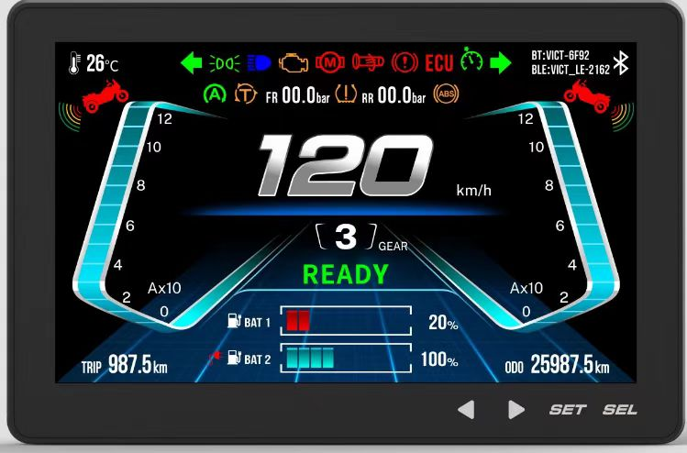
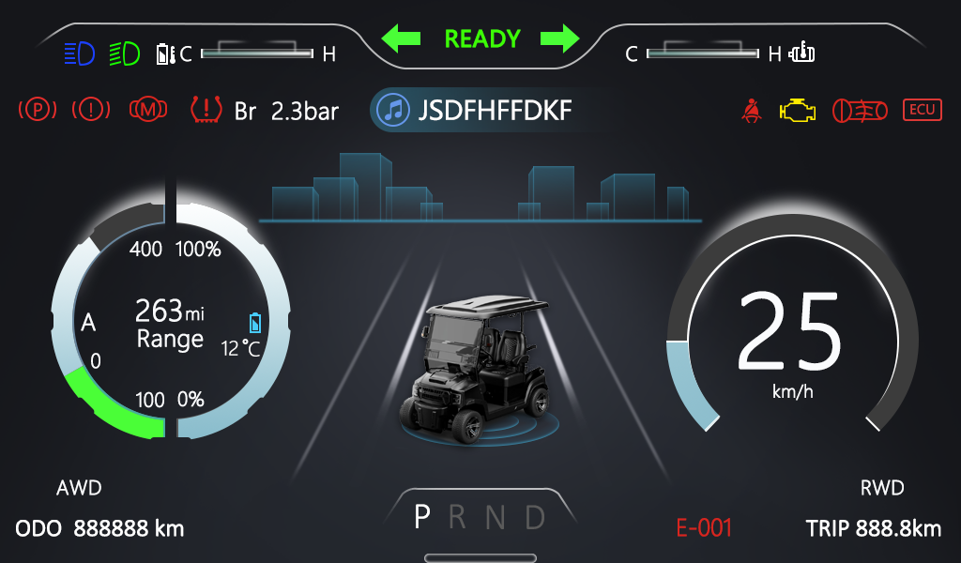
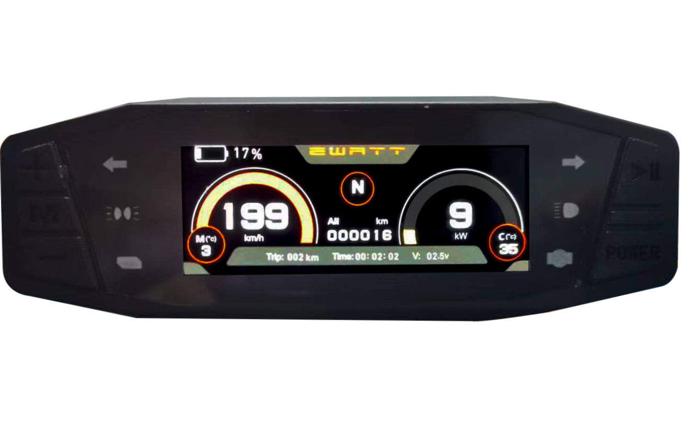
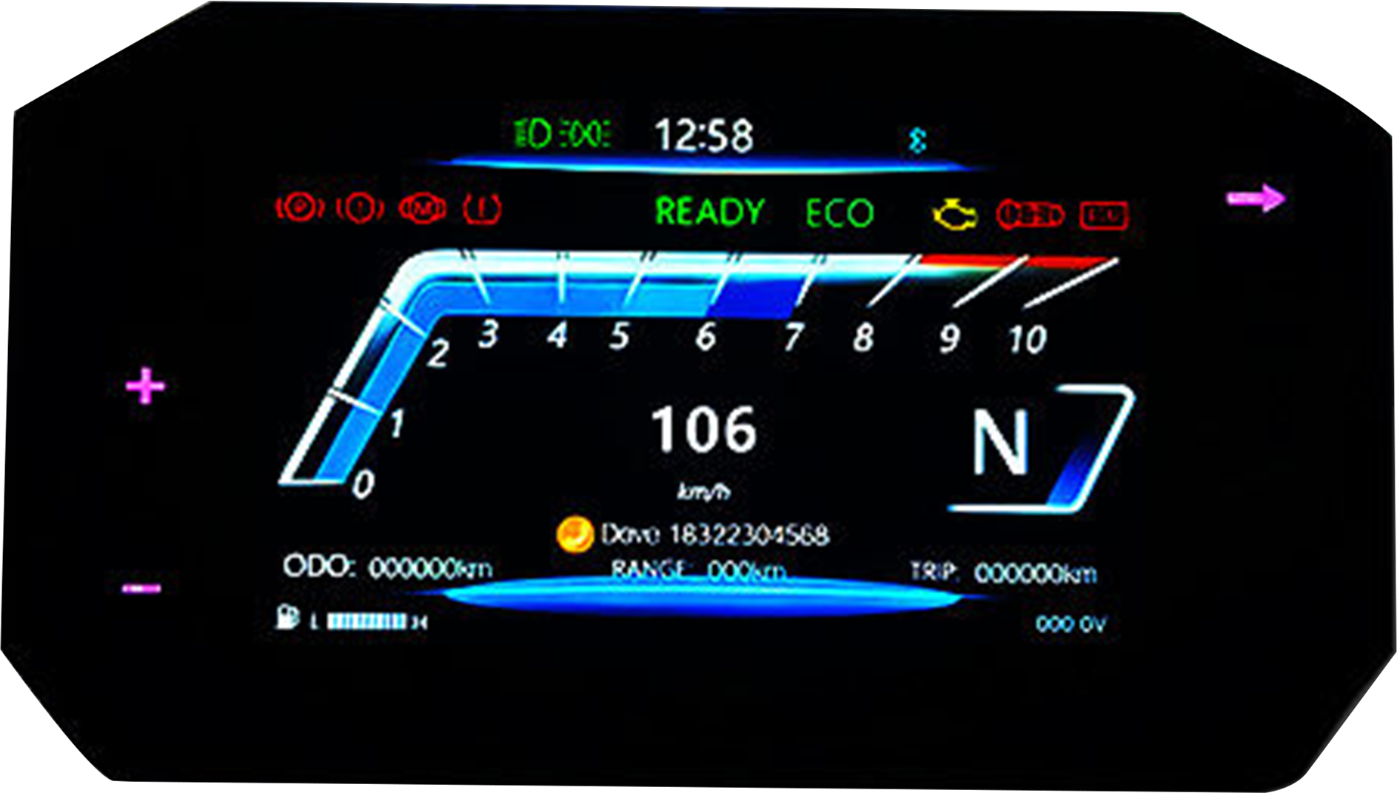
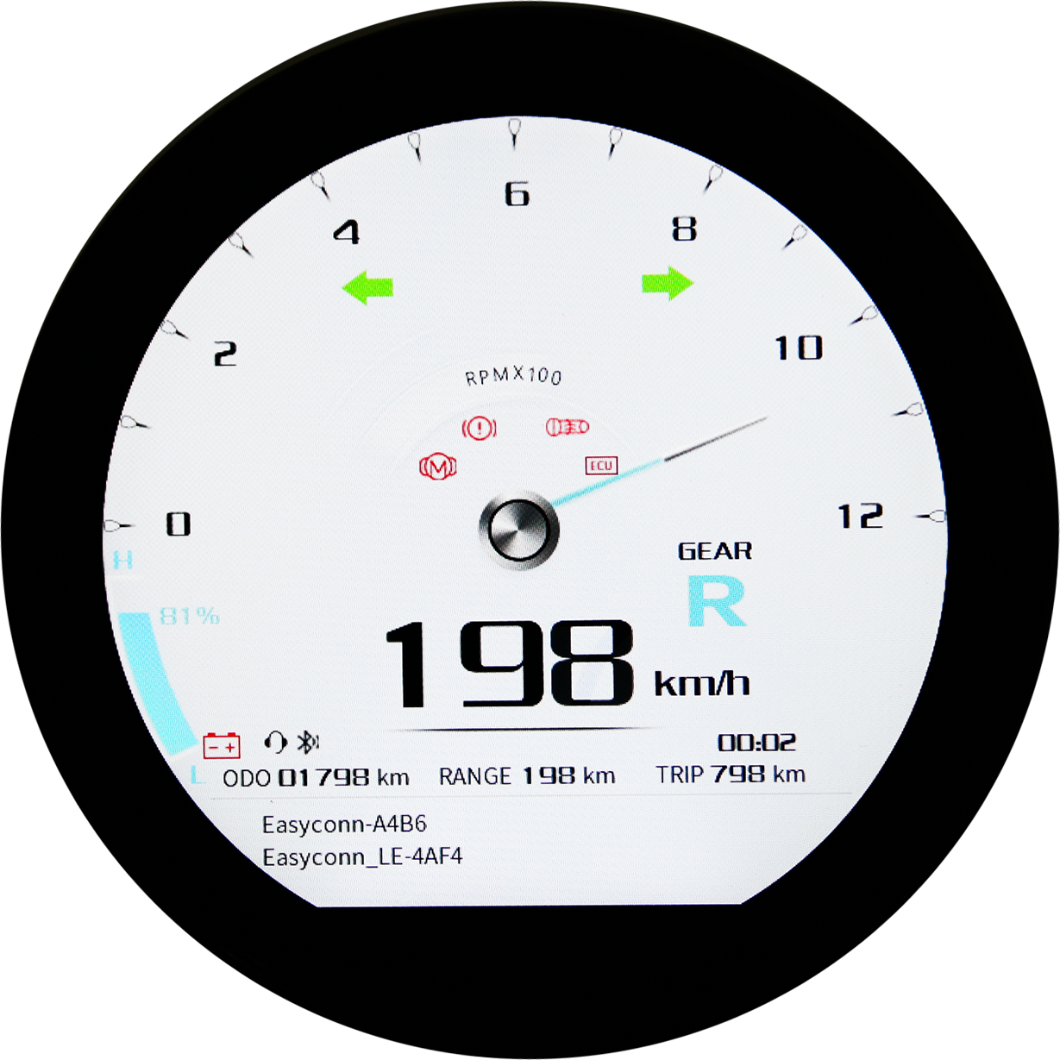
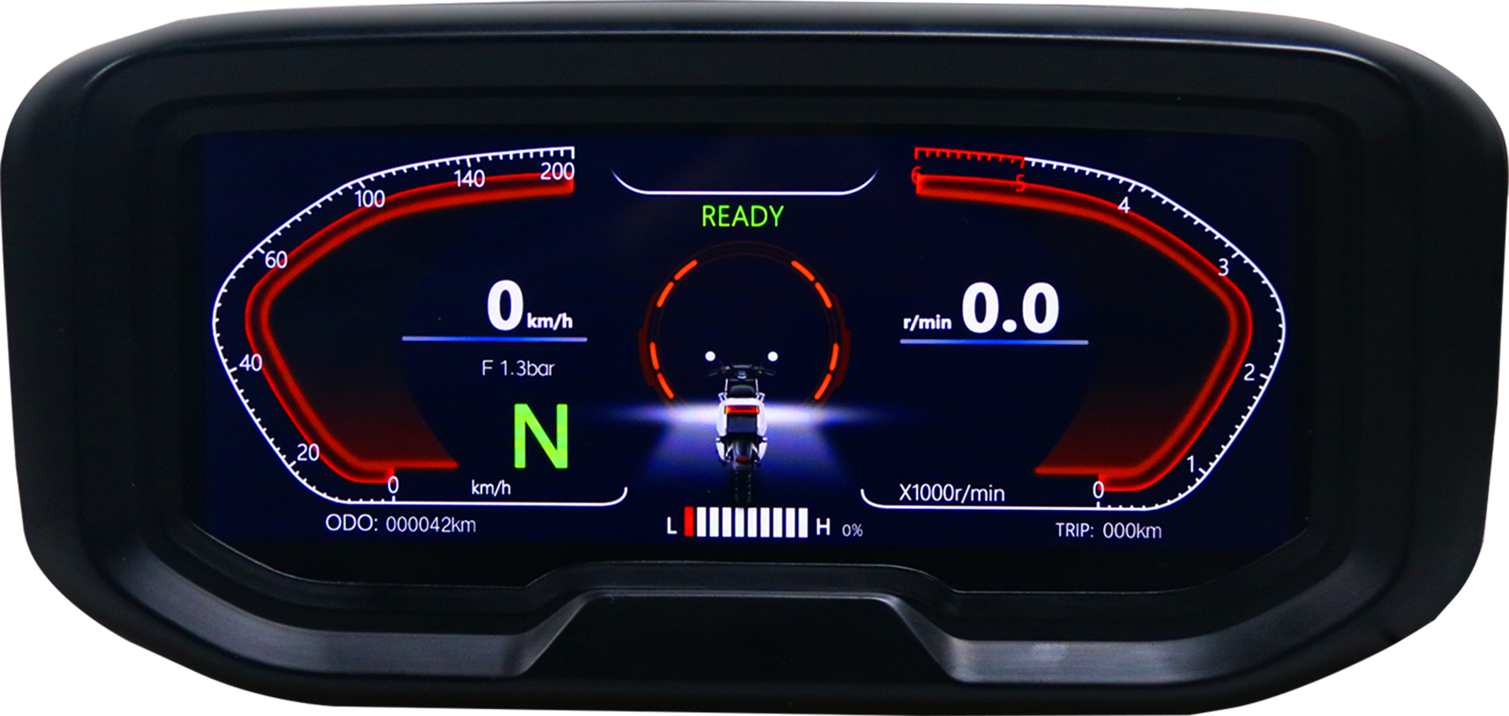
Products
5 inch
3.6 inch
6.8 inch
7 inch
9 inch
3.13 inch
TFT Display Basic Functions
Supported communication protocols: oneline, CANBUS, Hall, RS485
Highly adaptable to fardriver controller
Waterproof Level:IP65 | Ambient Temperature:-30℃ ~ 80 ℃ | Default support: oneline, FarDriver CAN18, Hall sensor
Speed | Left/Right Turn Signal | Ready Indication
P Gear | Gear DNR123 | Headlight
Total Mileage | Trip Mileage | Remaining Mileage
Volume up/down | Single/Dual Lithium Battery Level | Remaining Battery Level
Multimedia | Brake Alert | Vehicle Trouble
Bluetooth Connection | Kilometer/Mile Switching | USB Upgrade Port

Slide 4

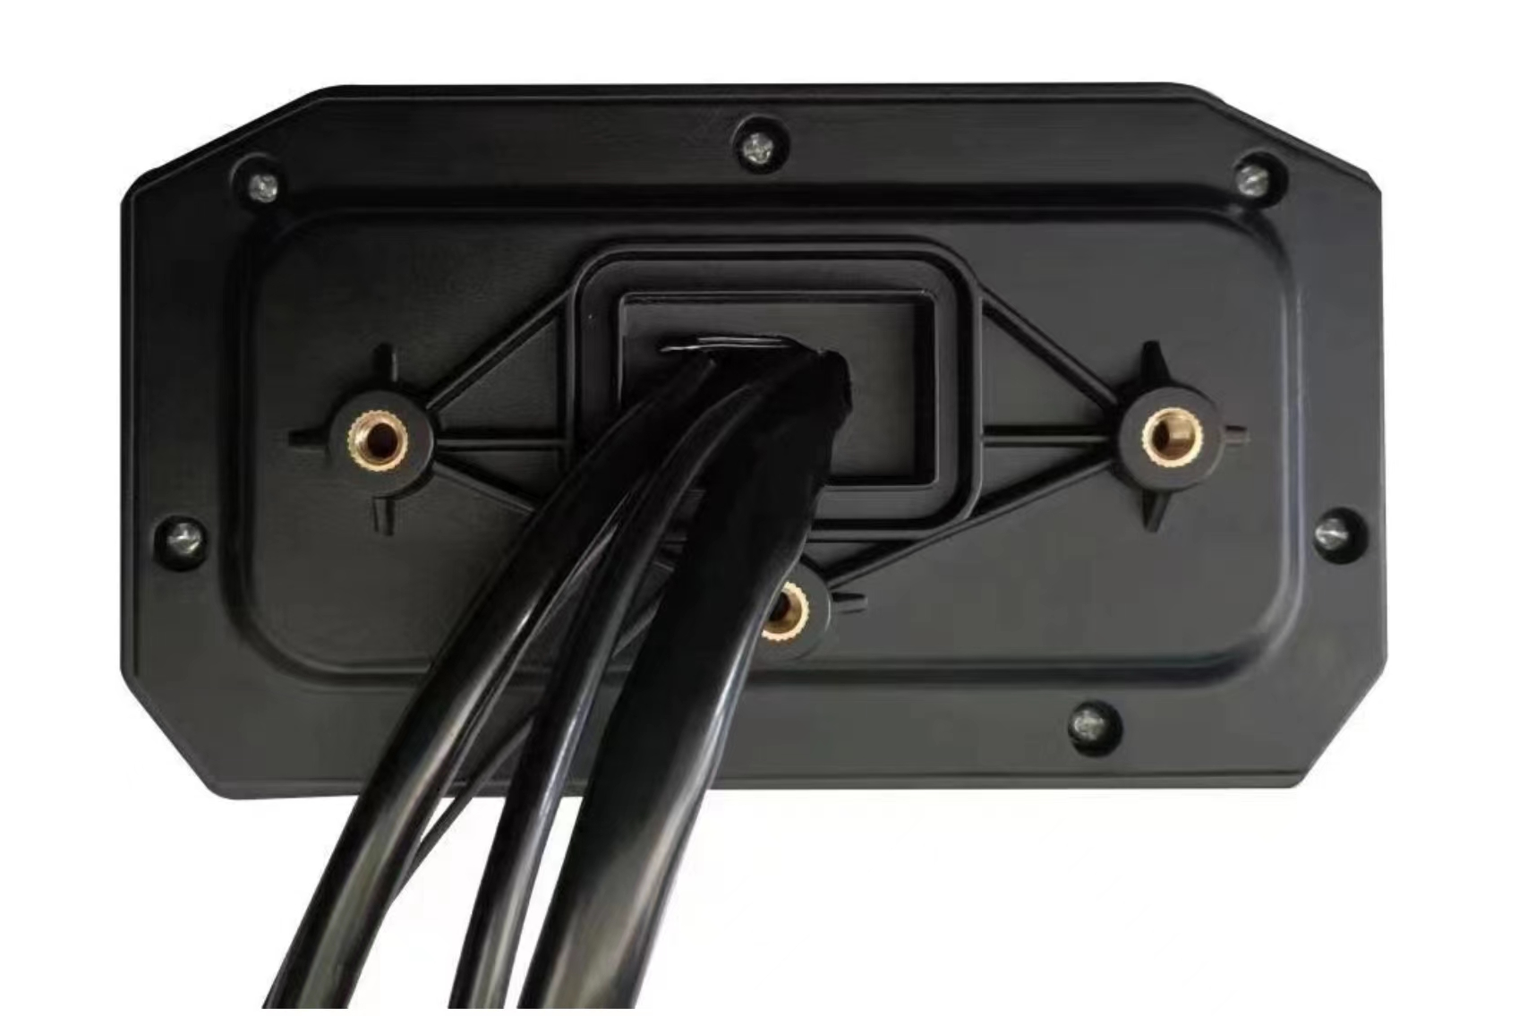
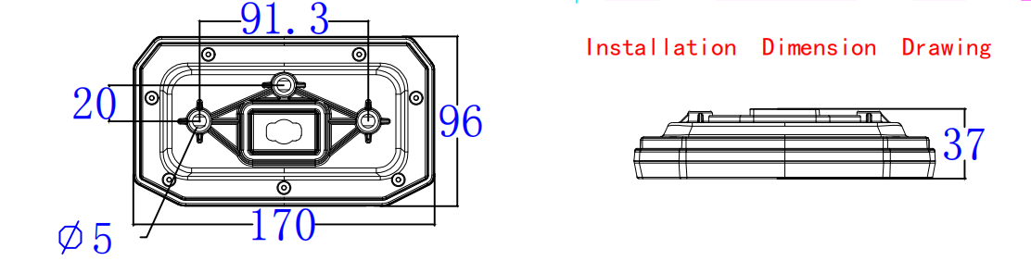
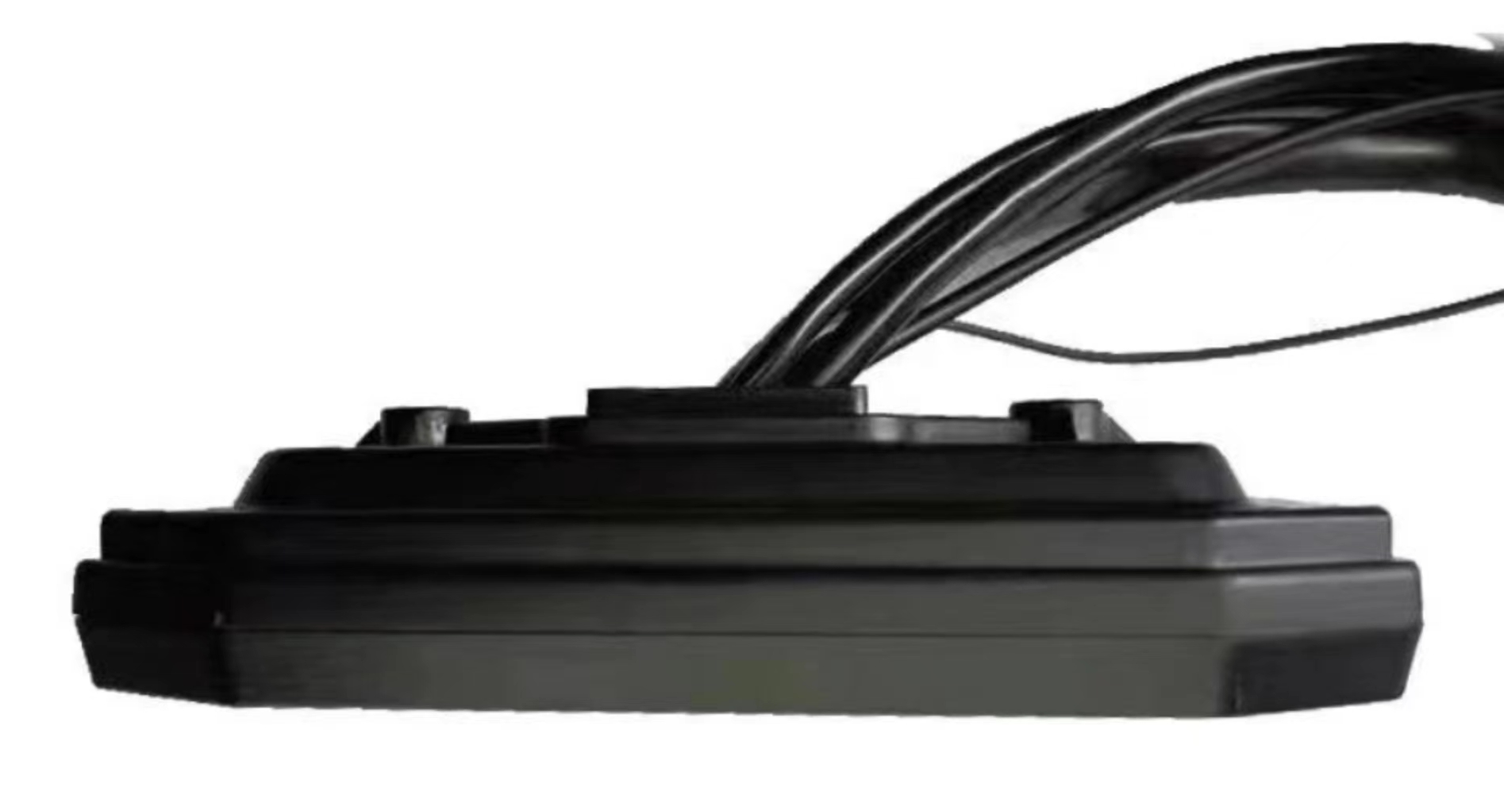
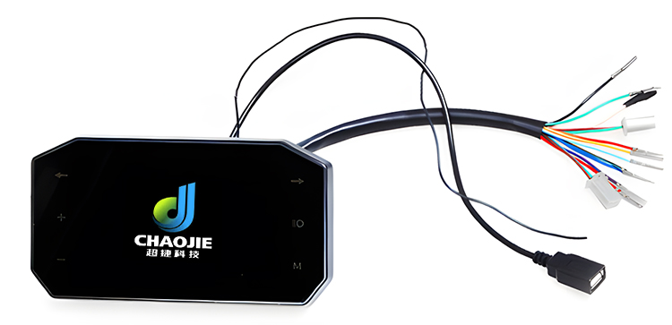
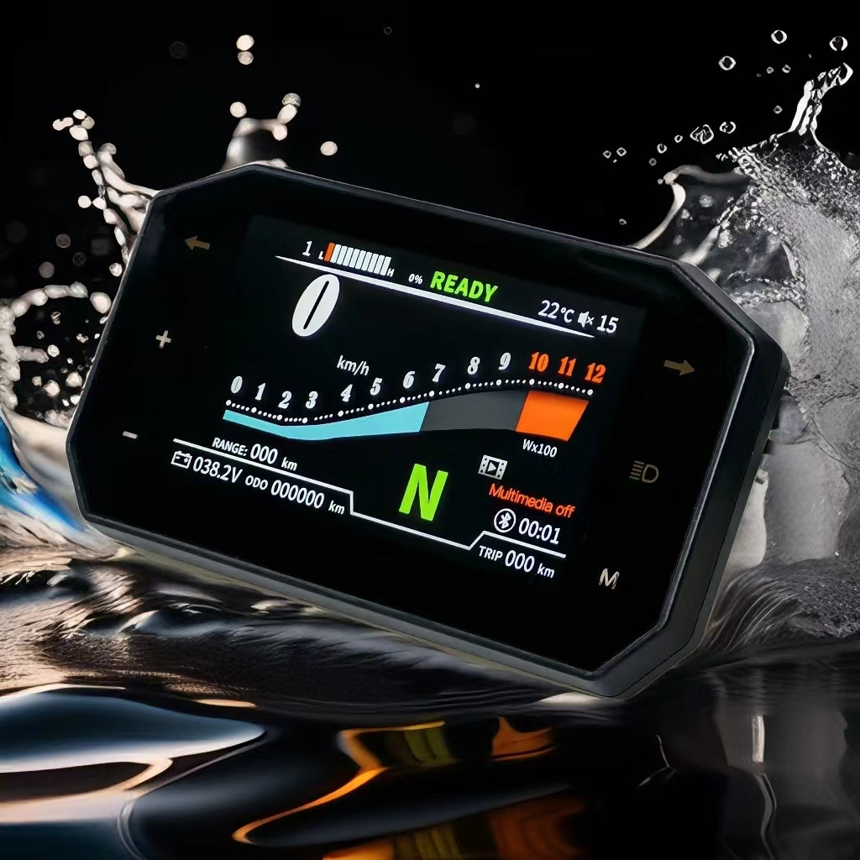
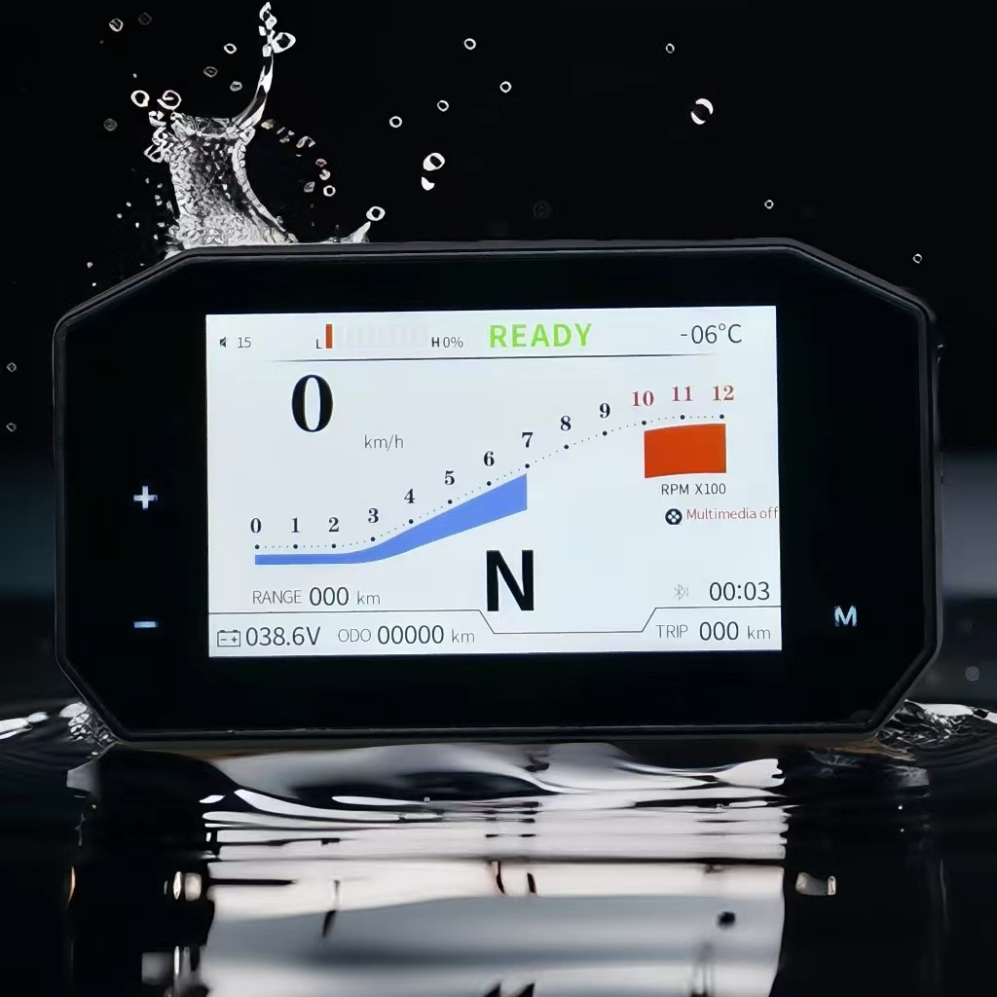
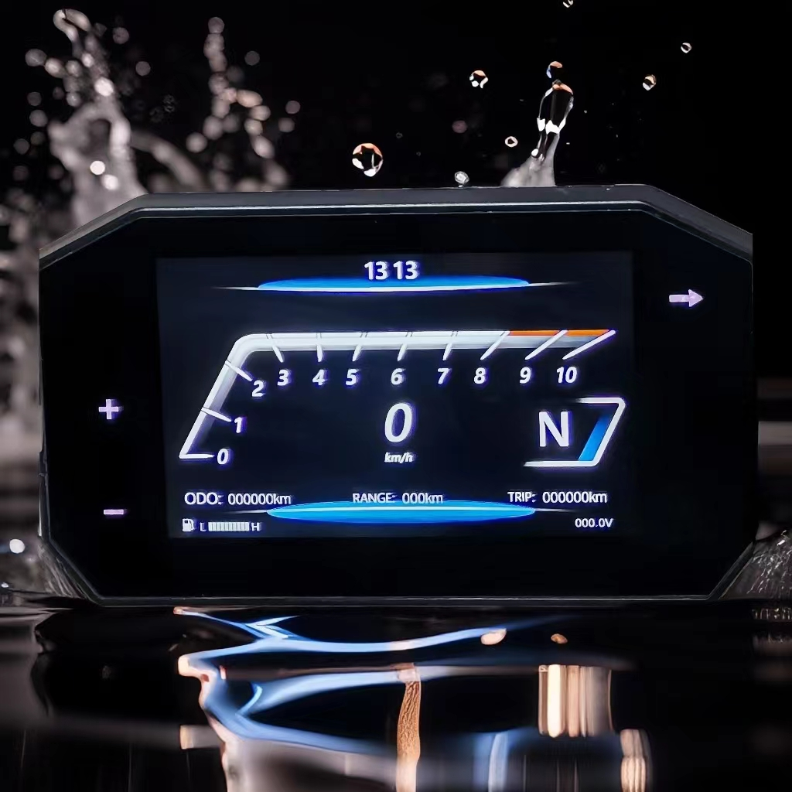
5-inch TFT Display
Appearance
Model
CJ-V5-01
CJ-V5-02
CJ-V5-03

Slide 5
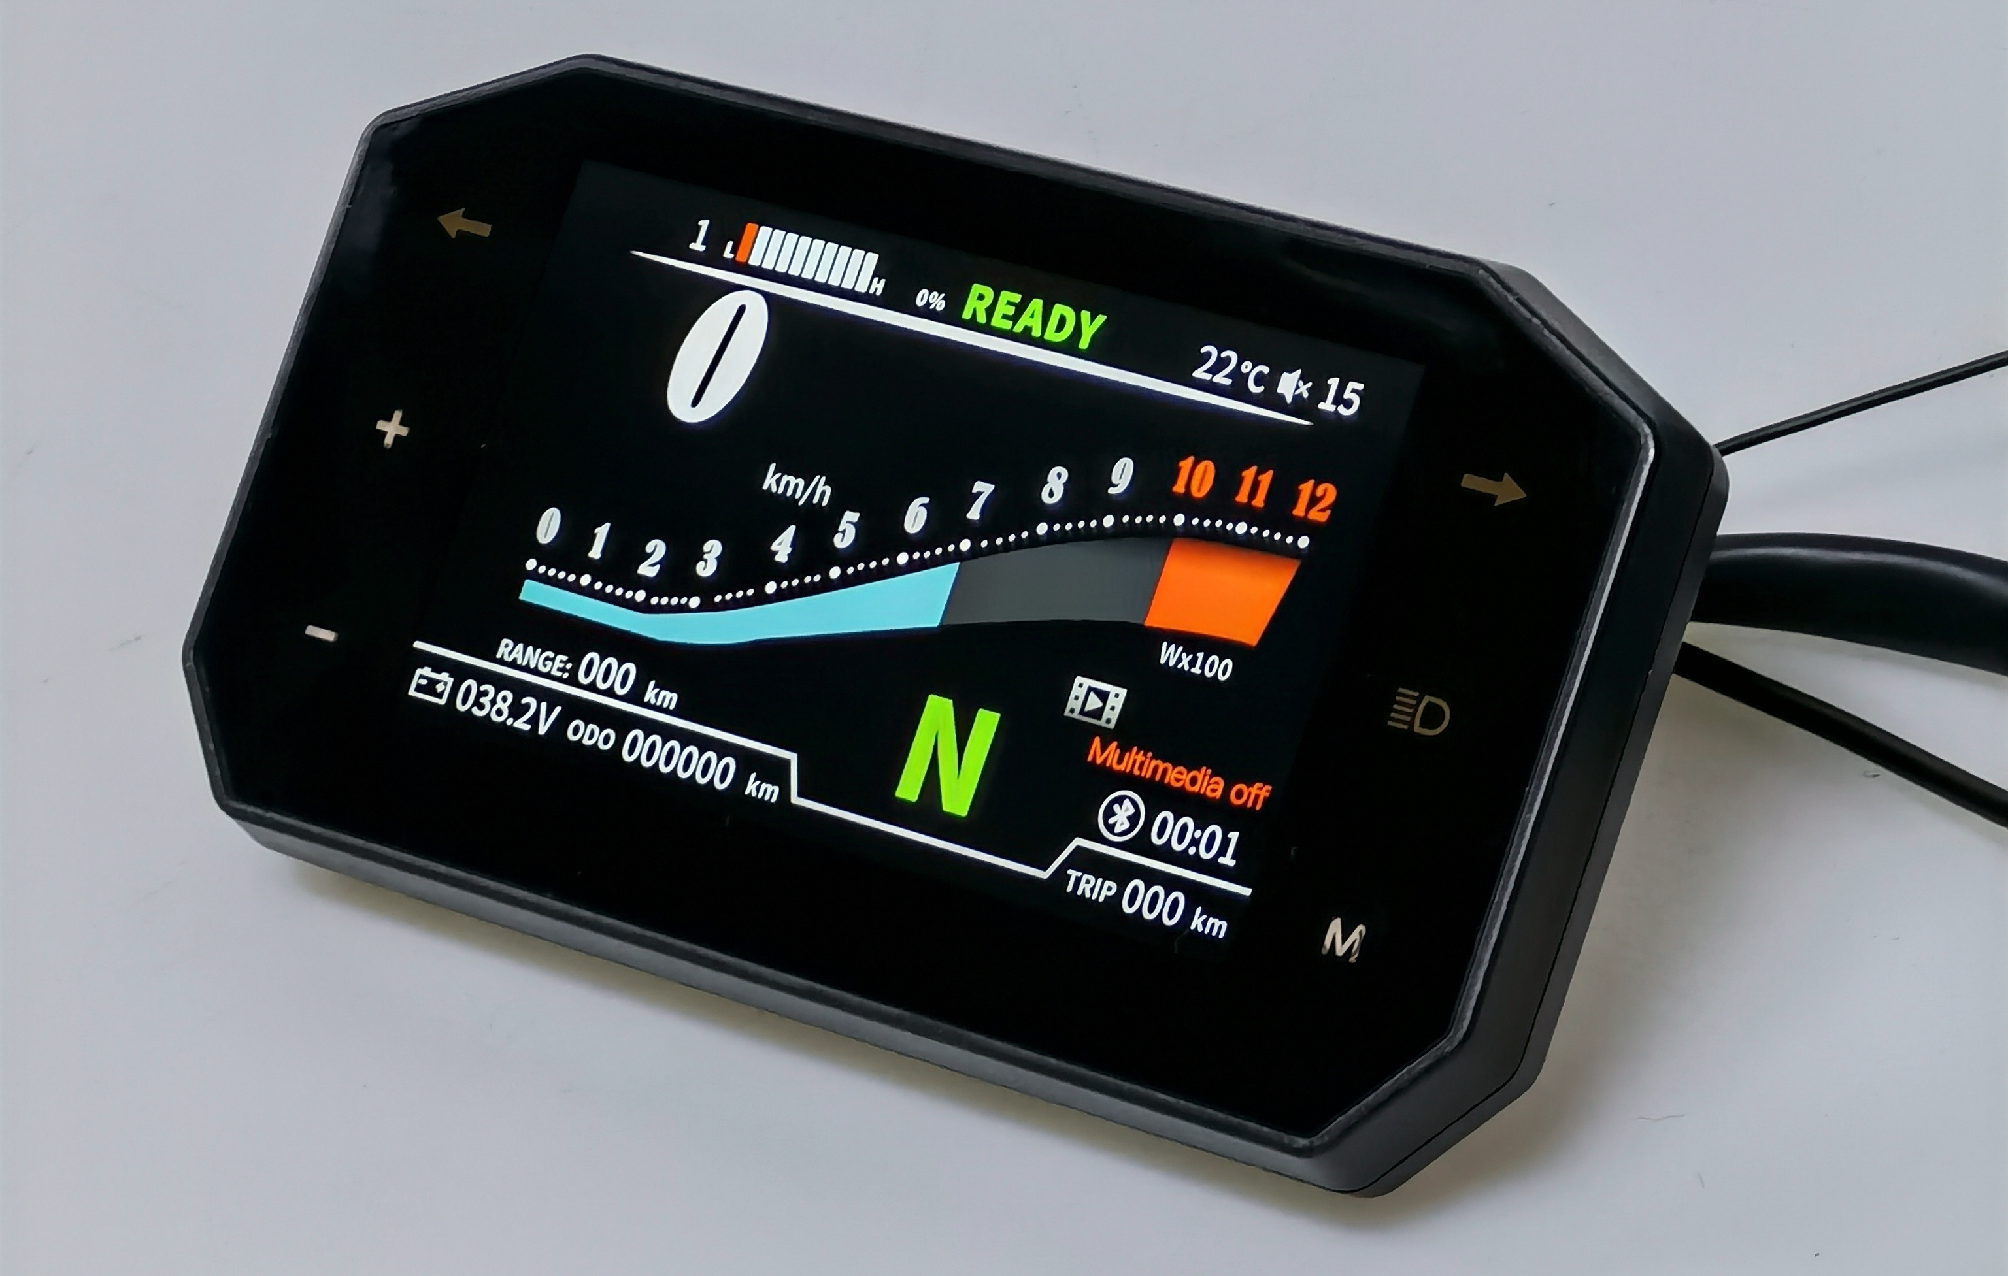
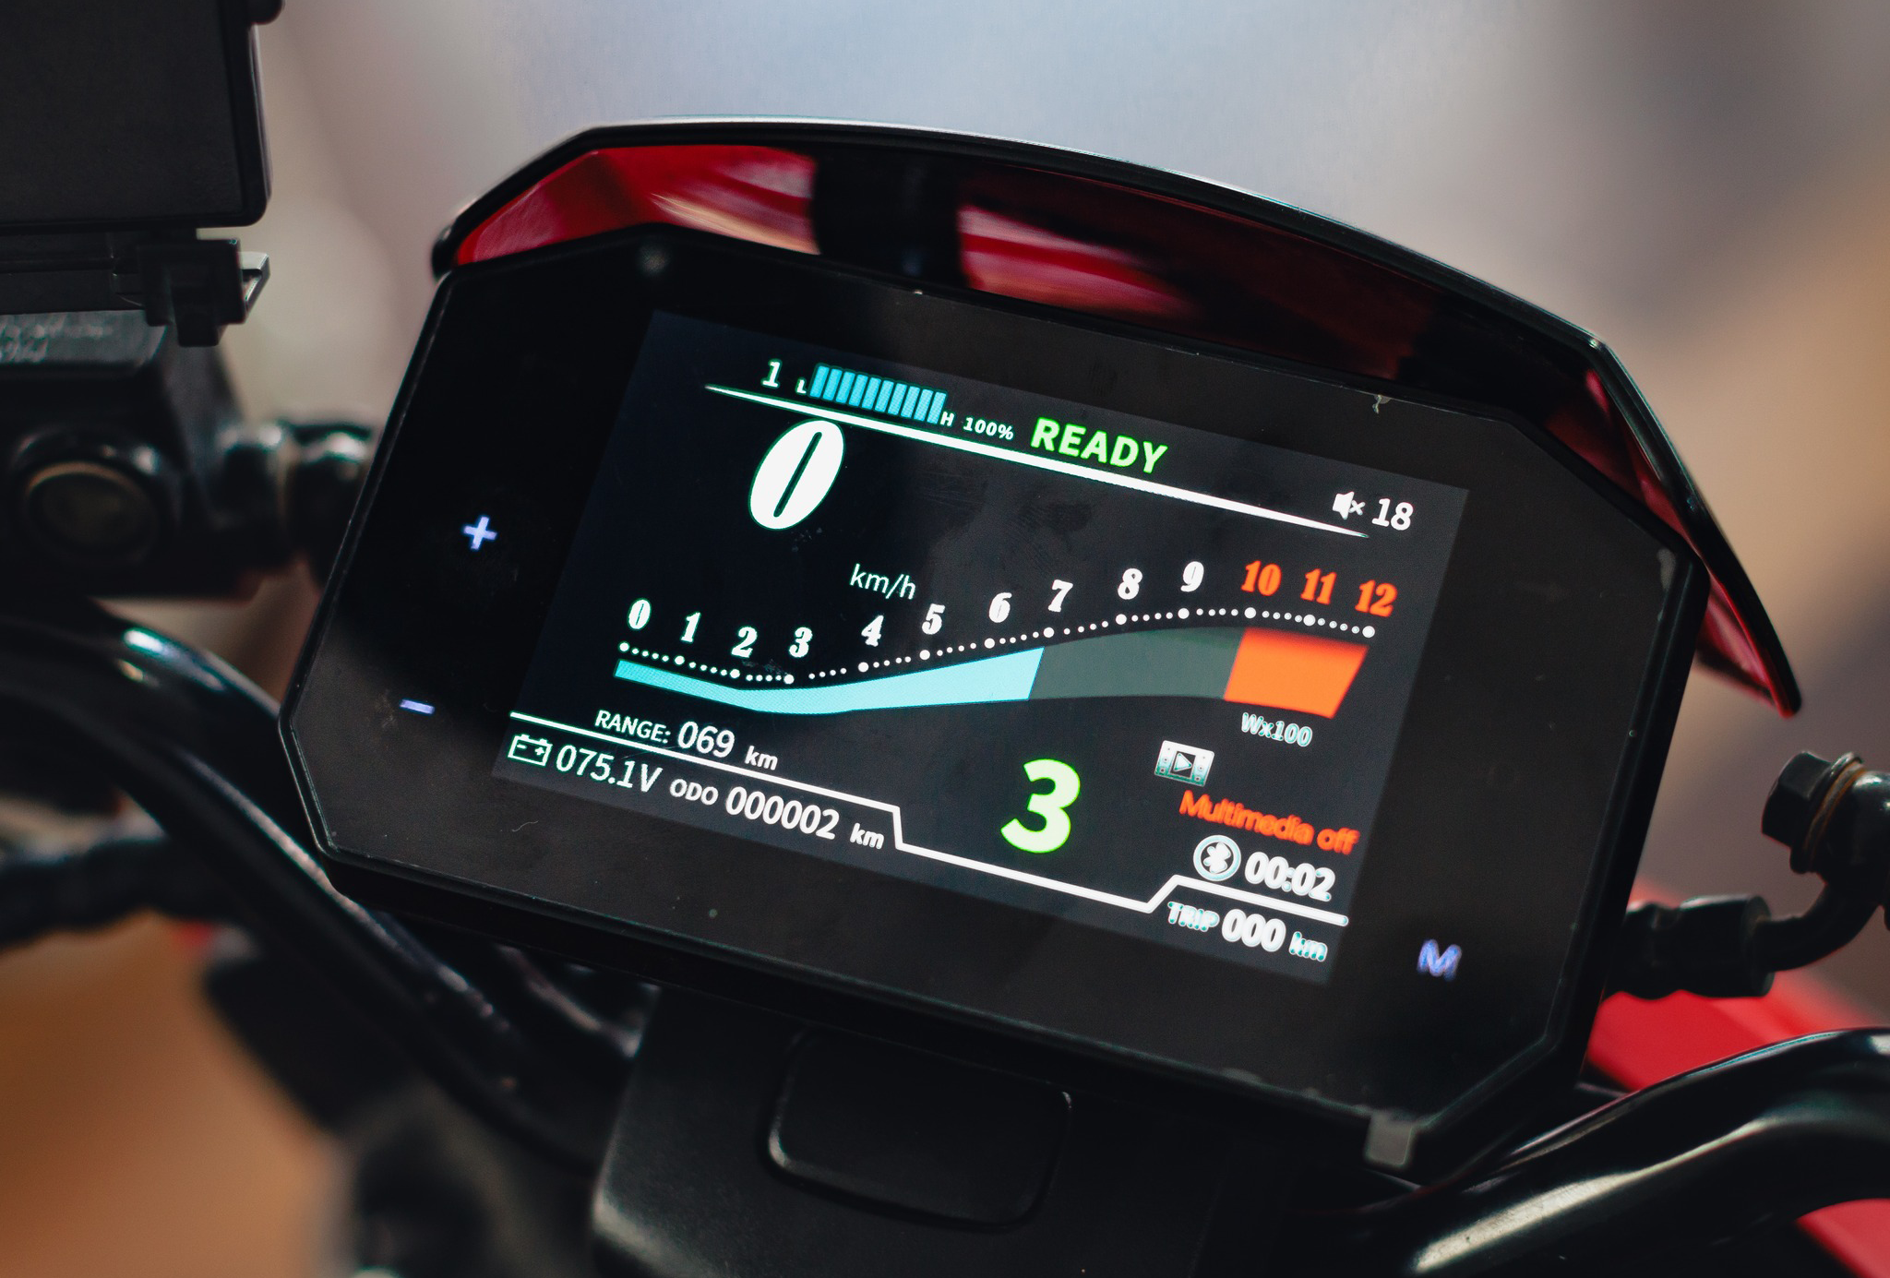
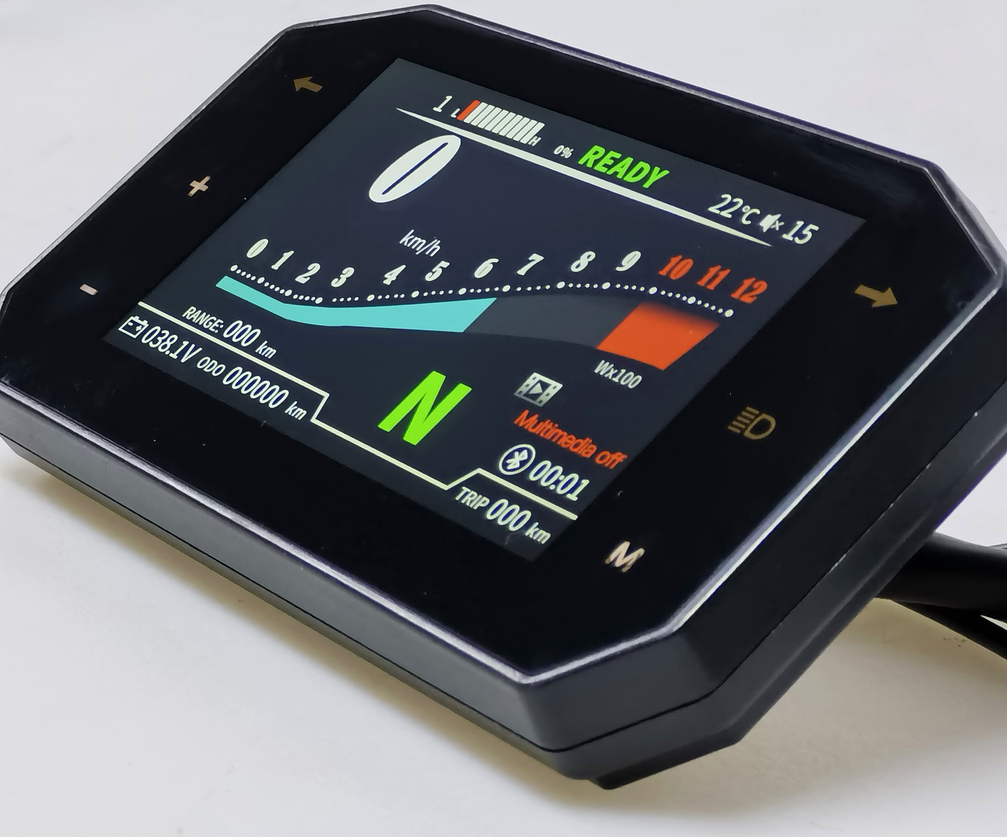
Products
5-inch TFT Display——CJ-V5-01
CJ-V5-01 Functions
Basic functions | Bluetooth connectivity for cell phones (answering calls) | USB flash drive playback (radio, music)
Screen Specifications
Withstand 96V rated voltage | Resolution: 800*480 | Brightness: 1000 cd/m²

Slide 6
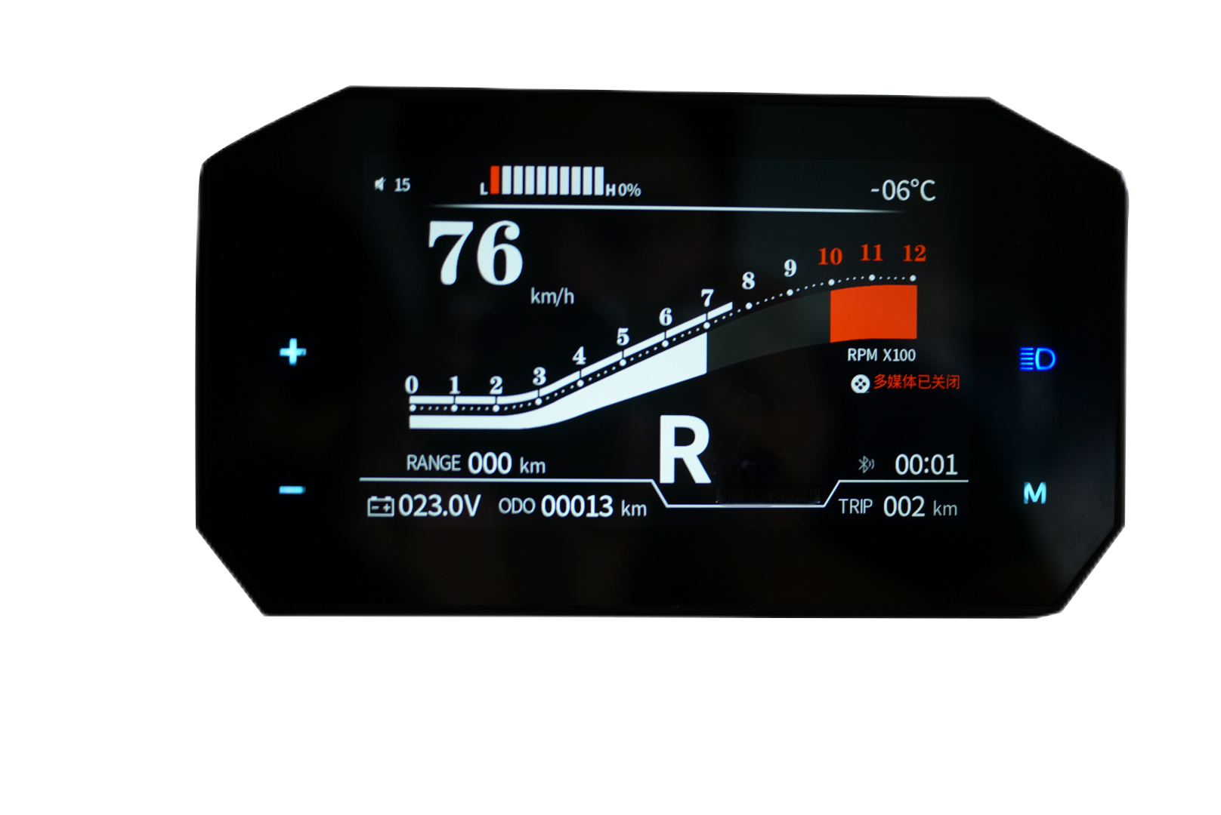
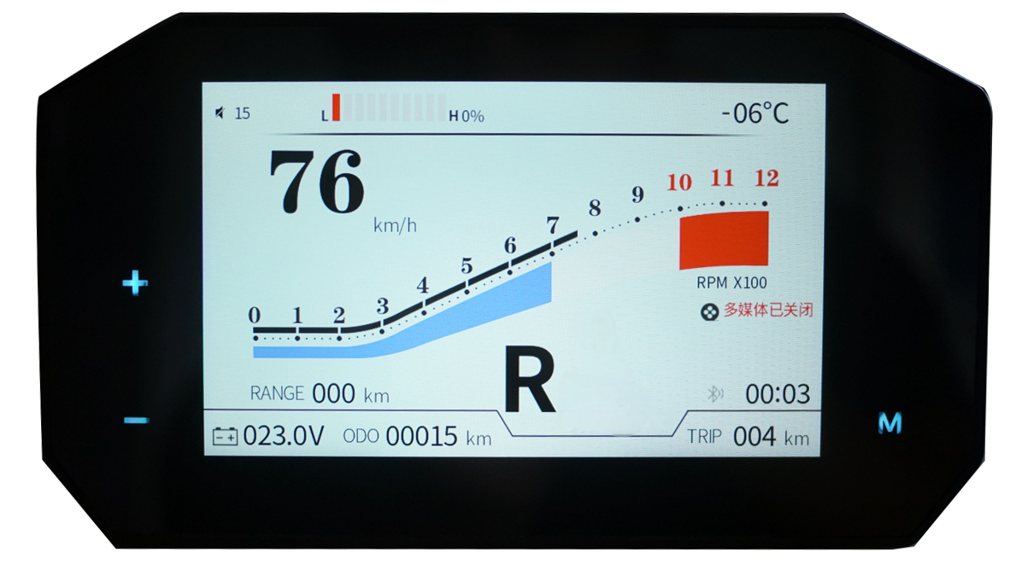

Products
5-inch TFT Display——CJ-V5-02
CJ-V5-02 Functions
Basic Functions | Connect to mobile phone via Bluetooth,allowing show incoming and outgoing calls | Turn on the headlights to switch backgrounds
Screen Specifications
Withstand 150V rated voltage | Resolution: 800*480 | Brightness: 1000 cd/m²

Slide 7
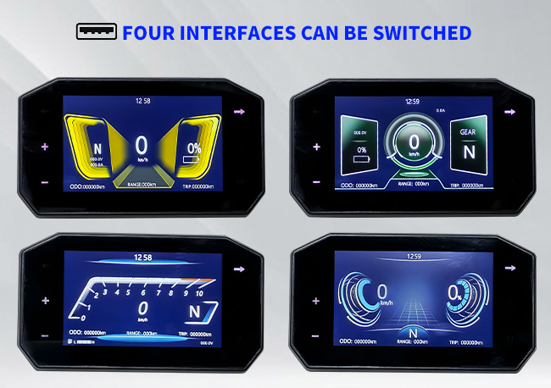
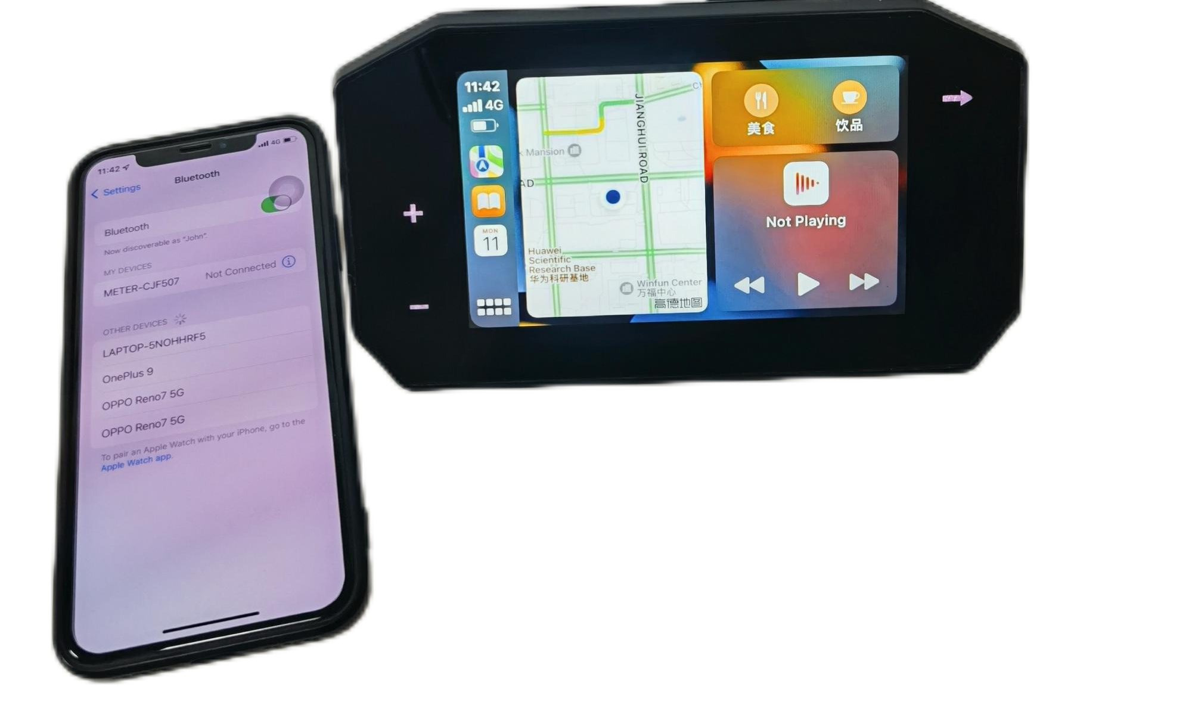
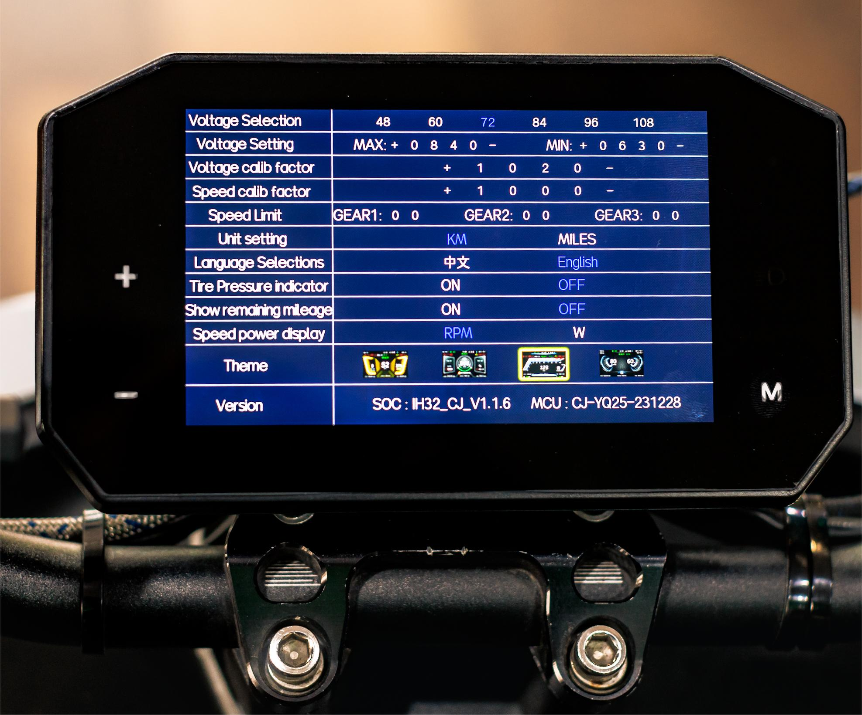
Products
5-inch TFT Display——CJ-V5-03
CJ-V5-03 Functions
Basic Functions | Supports iOS and Android (phones that support Android Auto) systems | Four interfaces switching Mobile casting
Screen Specifications
Withstand 150V rated voltage | Resolution: 800*480 | Brightness: 1000 cd/m²

Slide 8
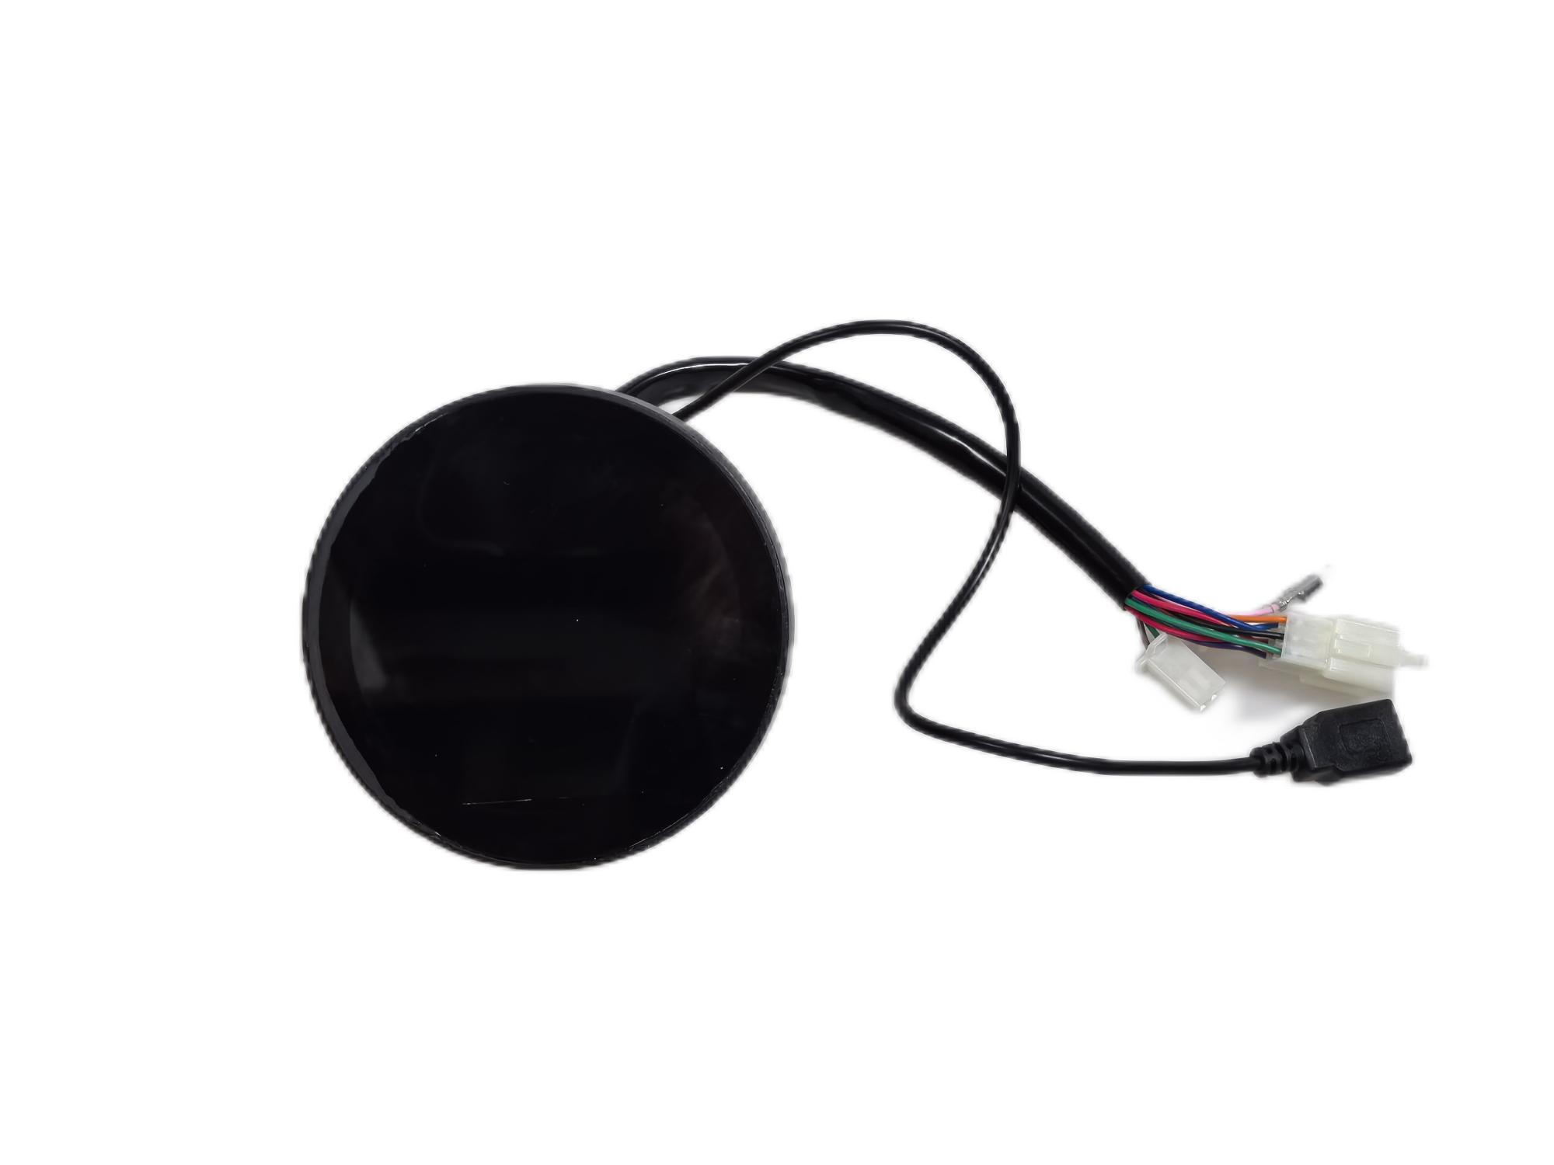
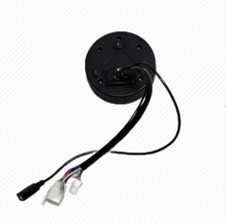
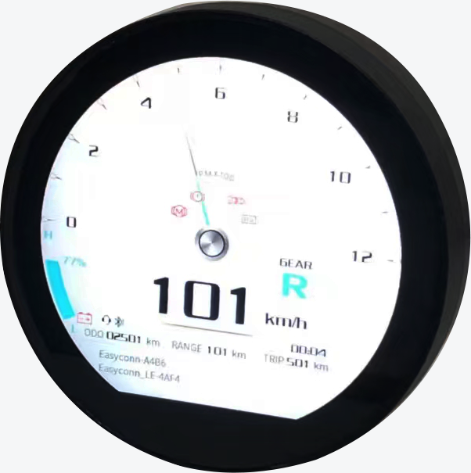
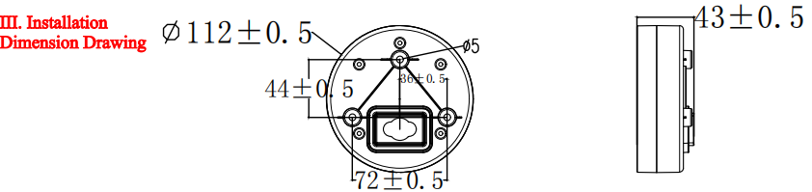
3.6-inch Round Display
Appearance

Slide 9
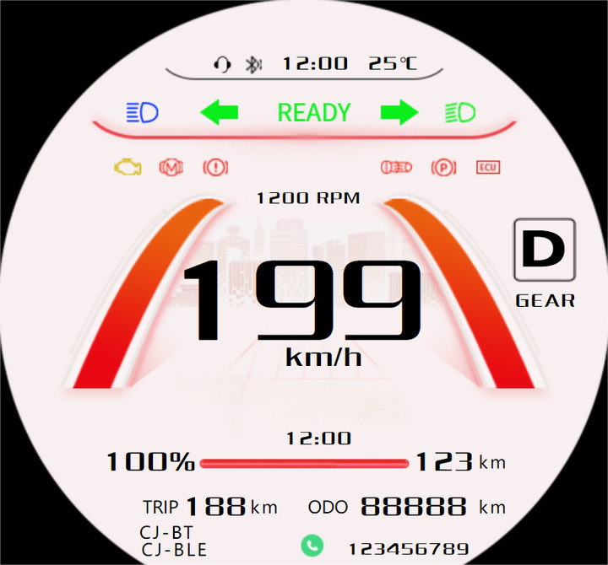
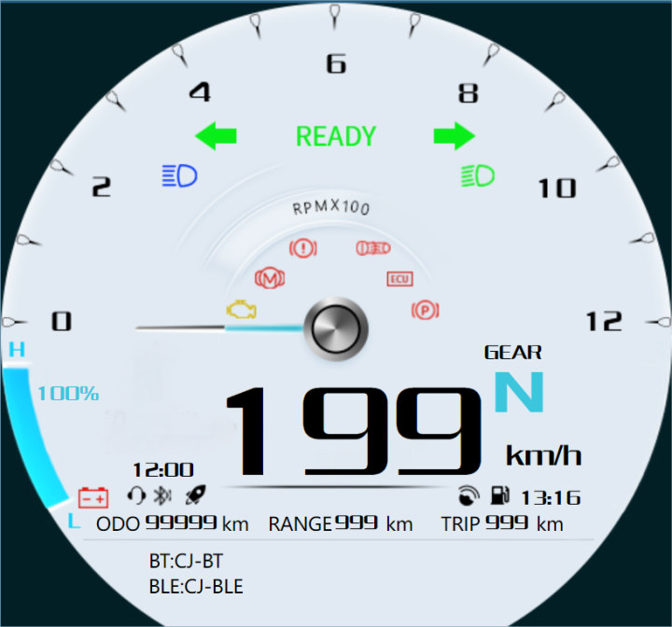
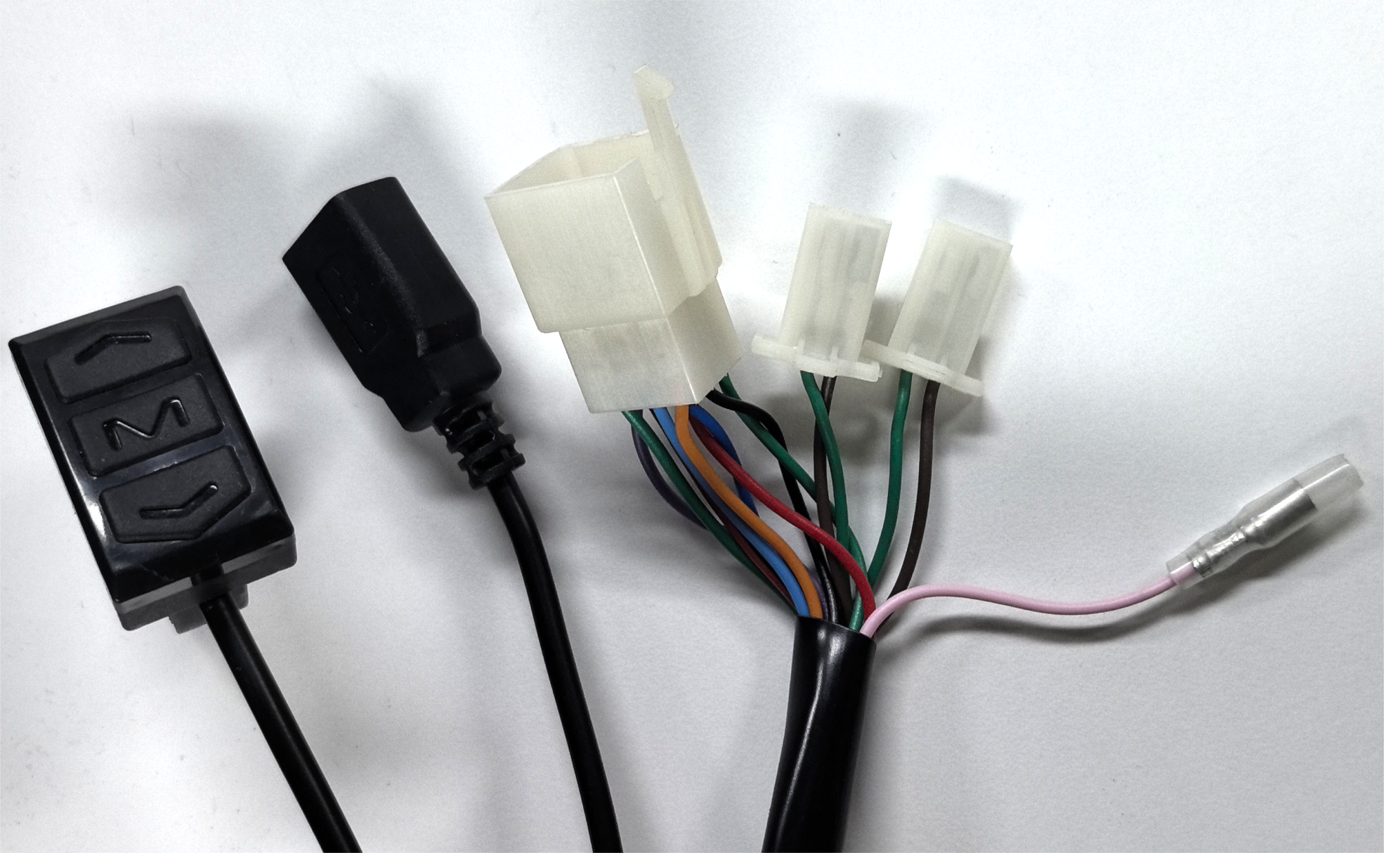
Products
Round TFT Display——CJ-R3-04
CJ-R3-04 Functions
Basic Functions | Connect to mobile phone via Bluetooth,allowing show incoming and outgoing calls | Select two user interfaces based on preference / turn on headlights to switch backgrounds
Screen Specifications
Withstands 150V rated voltage | Resolution: 544*506 | Brightness: 1000 cd/m²

Slide 10
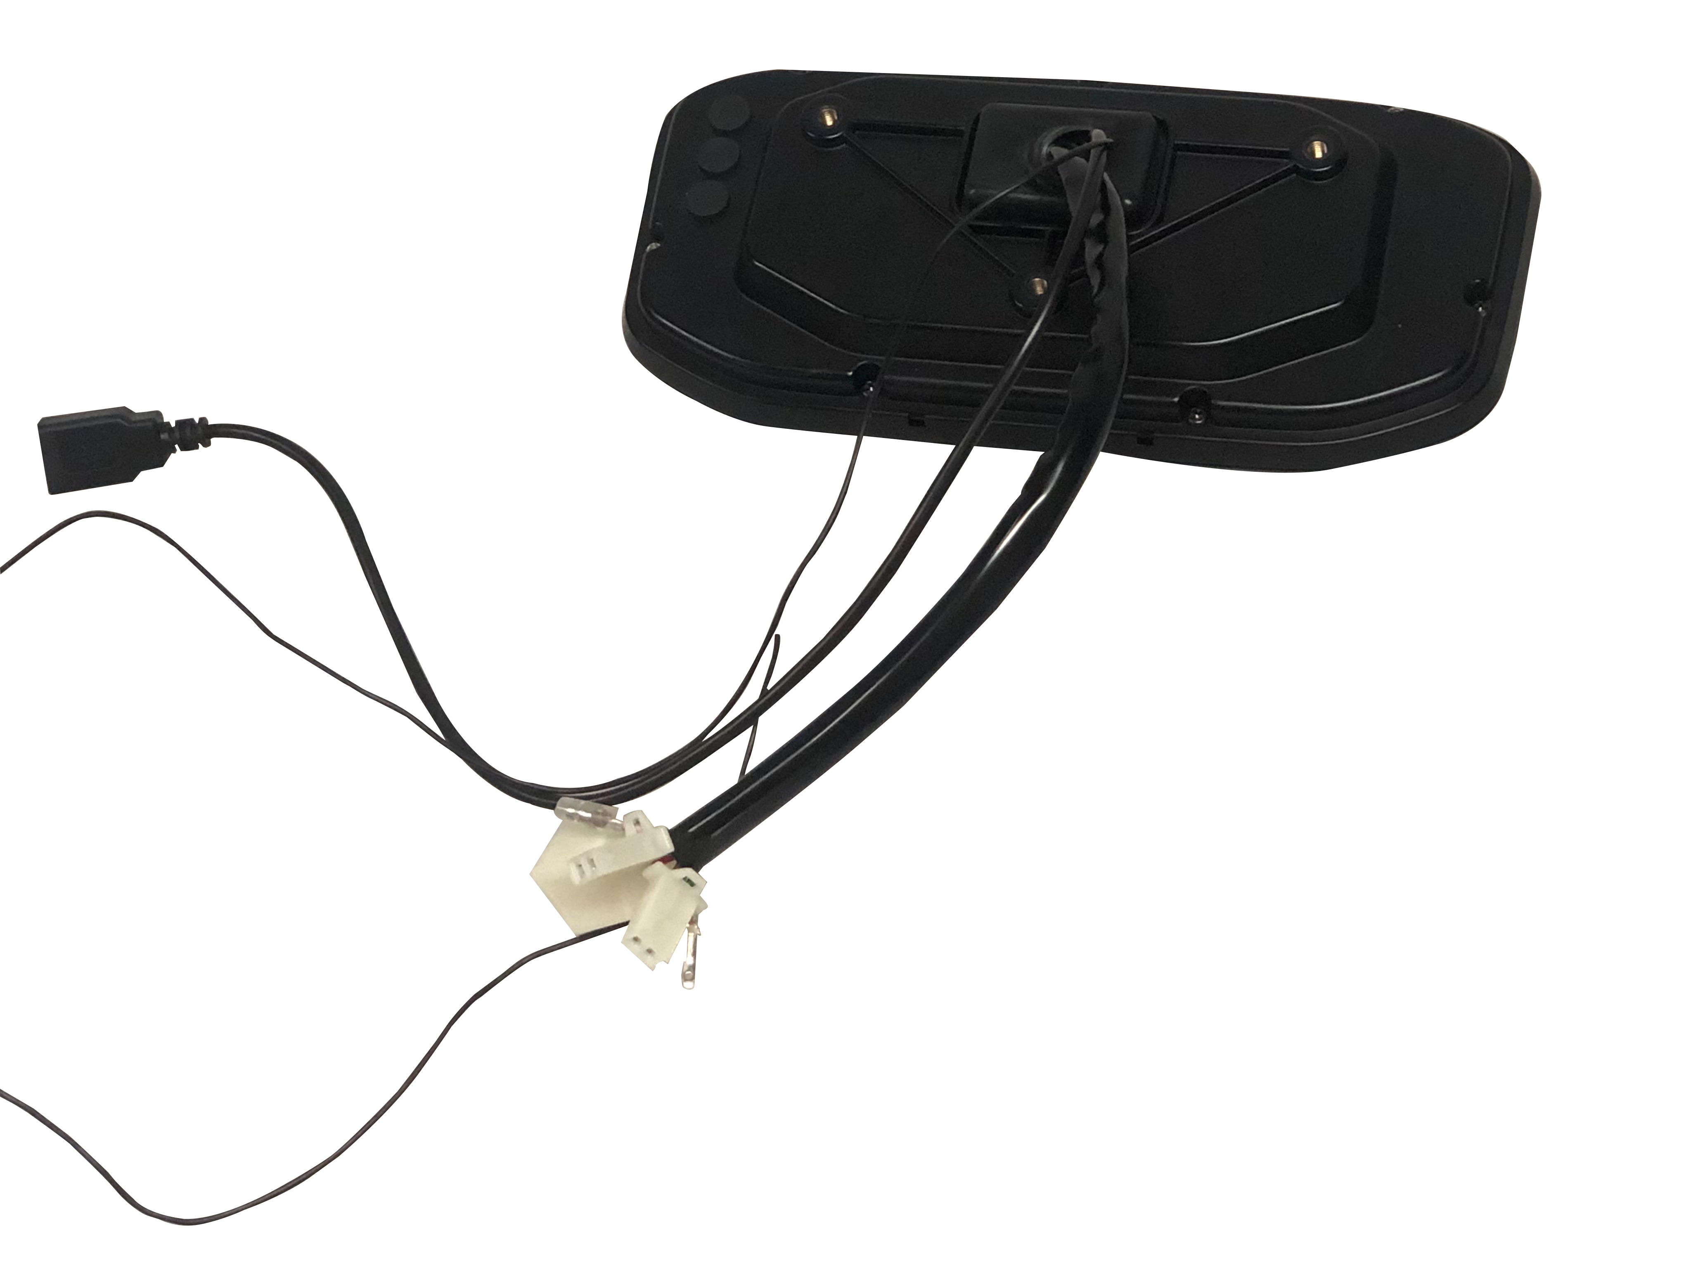
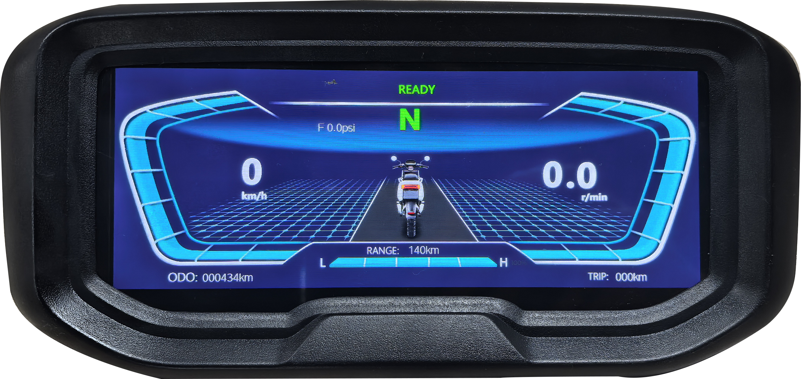
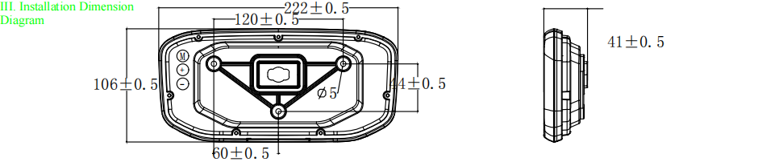
6.86-inch TFT Display
Appearance

Slide 11
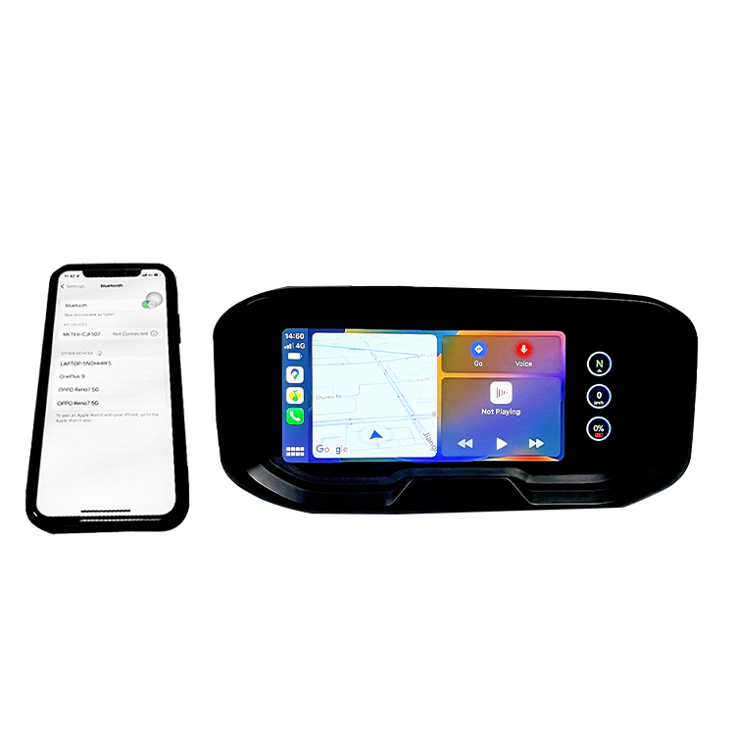
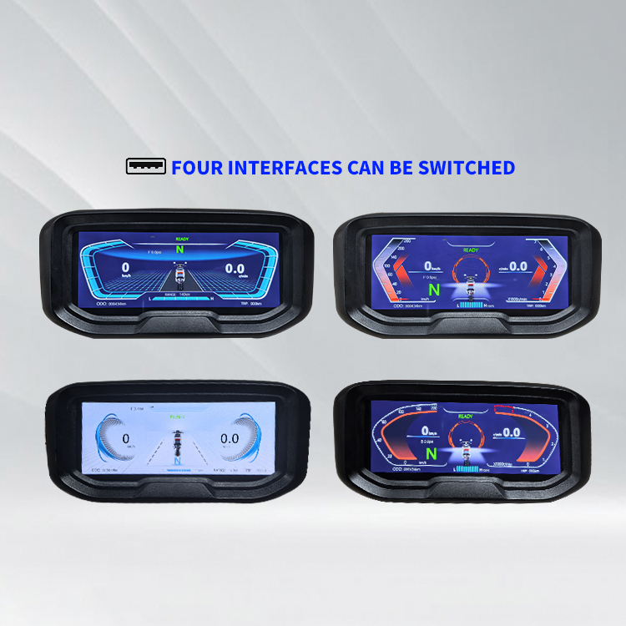
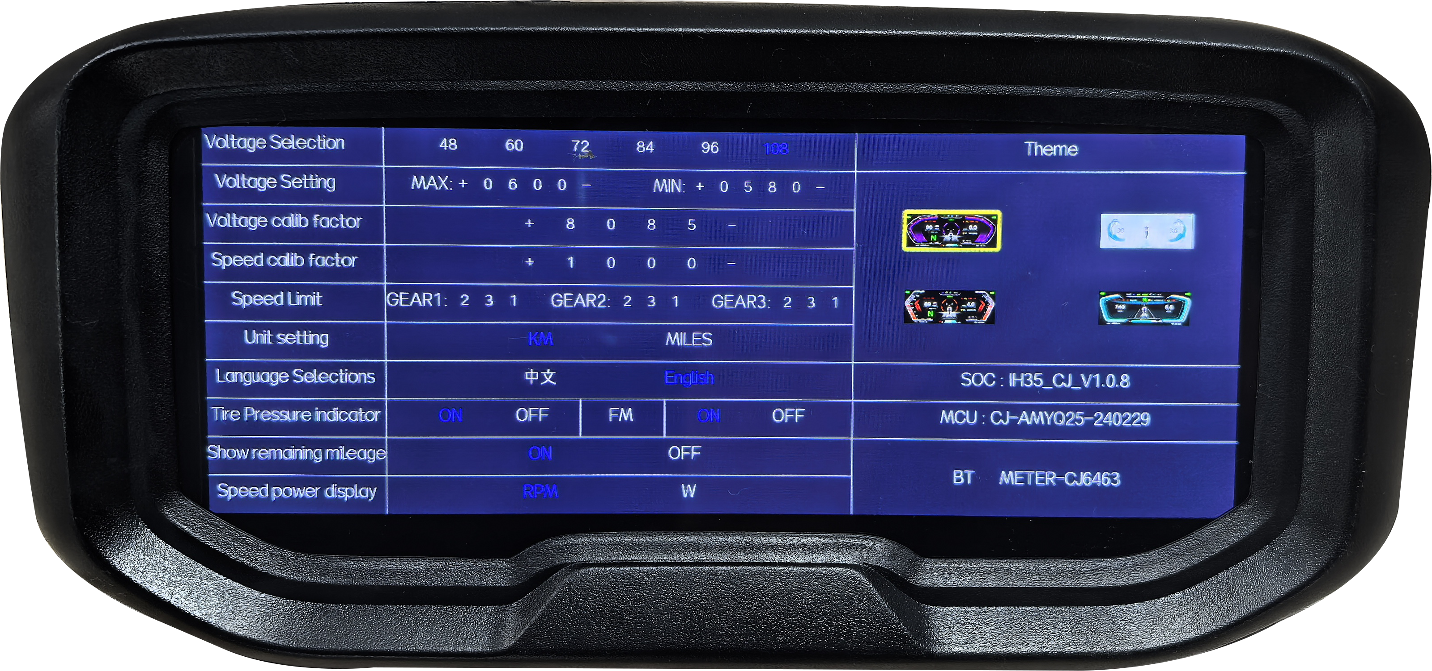
Products
6.86inchTFT Display——CJ-V6-01
CJ-V6-01 Functions
Basic Functions | Support mobile iOS and Android (phones that support Android Auto) systems | Four interface switching Mobile casting
Screen Specifications
Withstand 150V rated voltage | Resolution: 480*1280 | Brightness: 1000 cd/m²

Slide 12
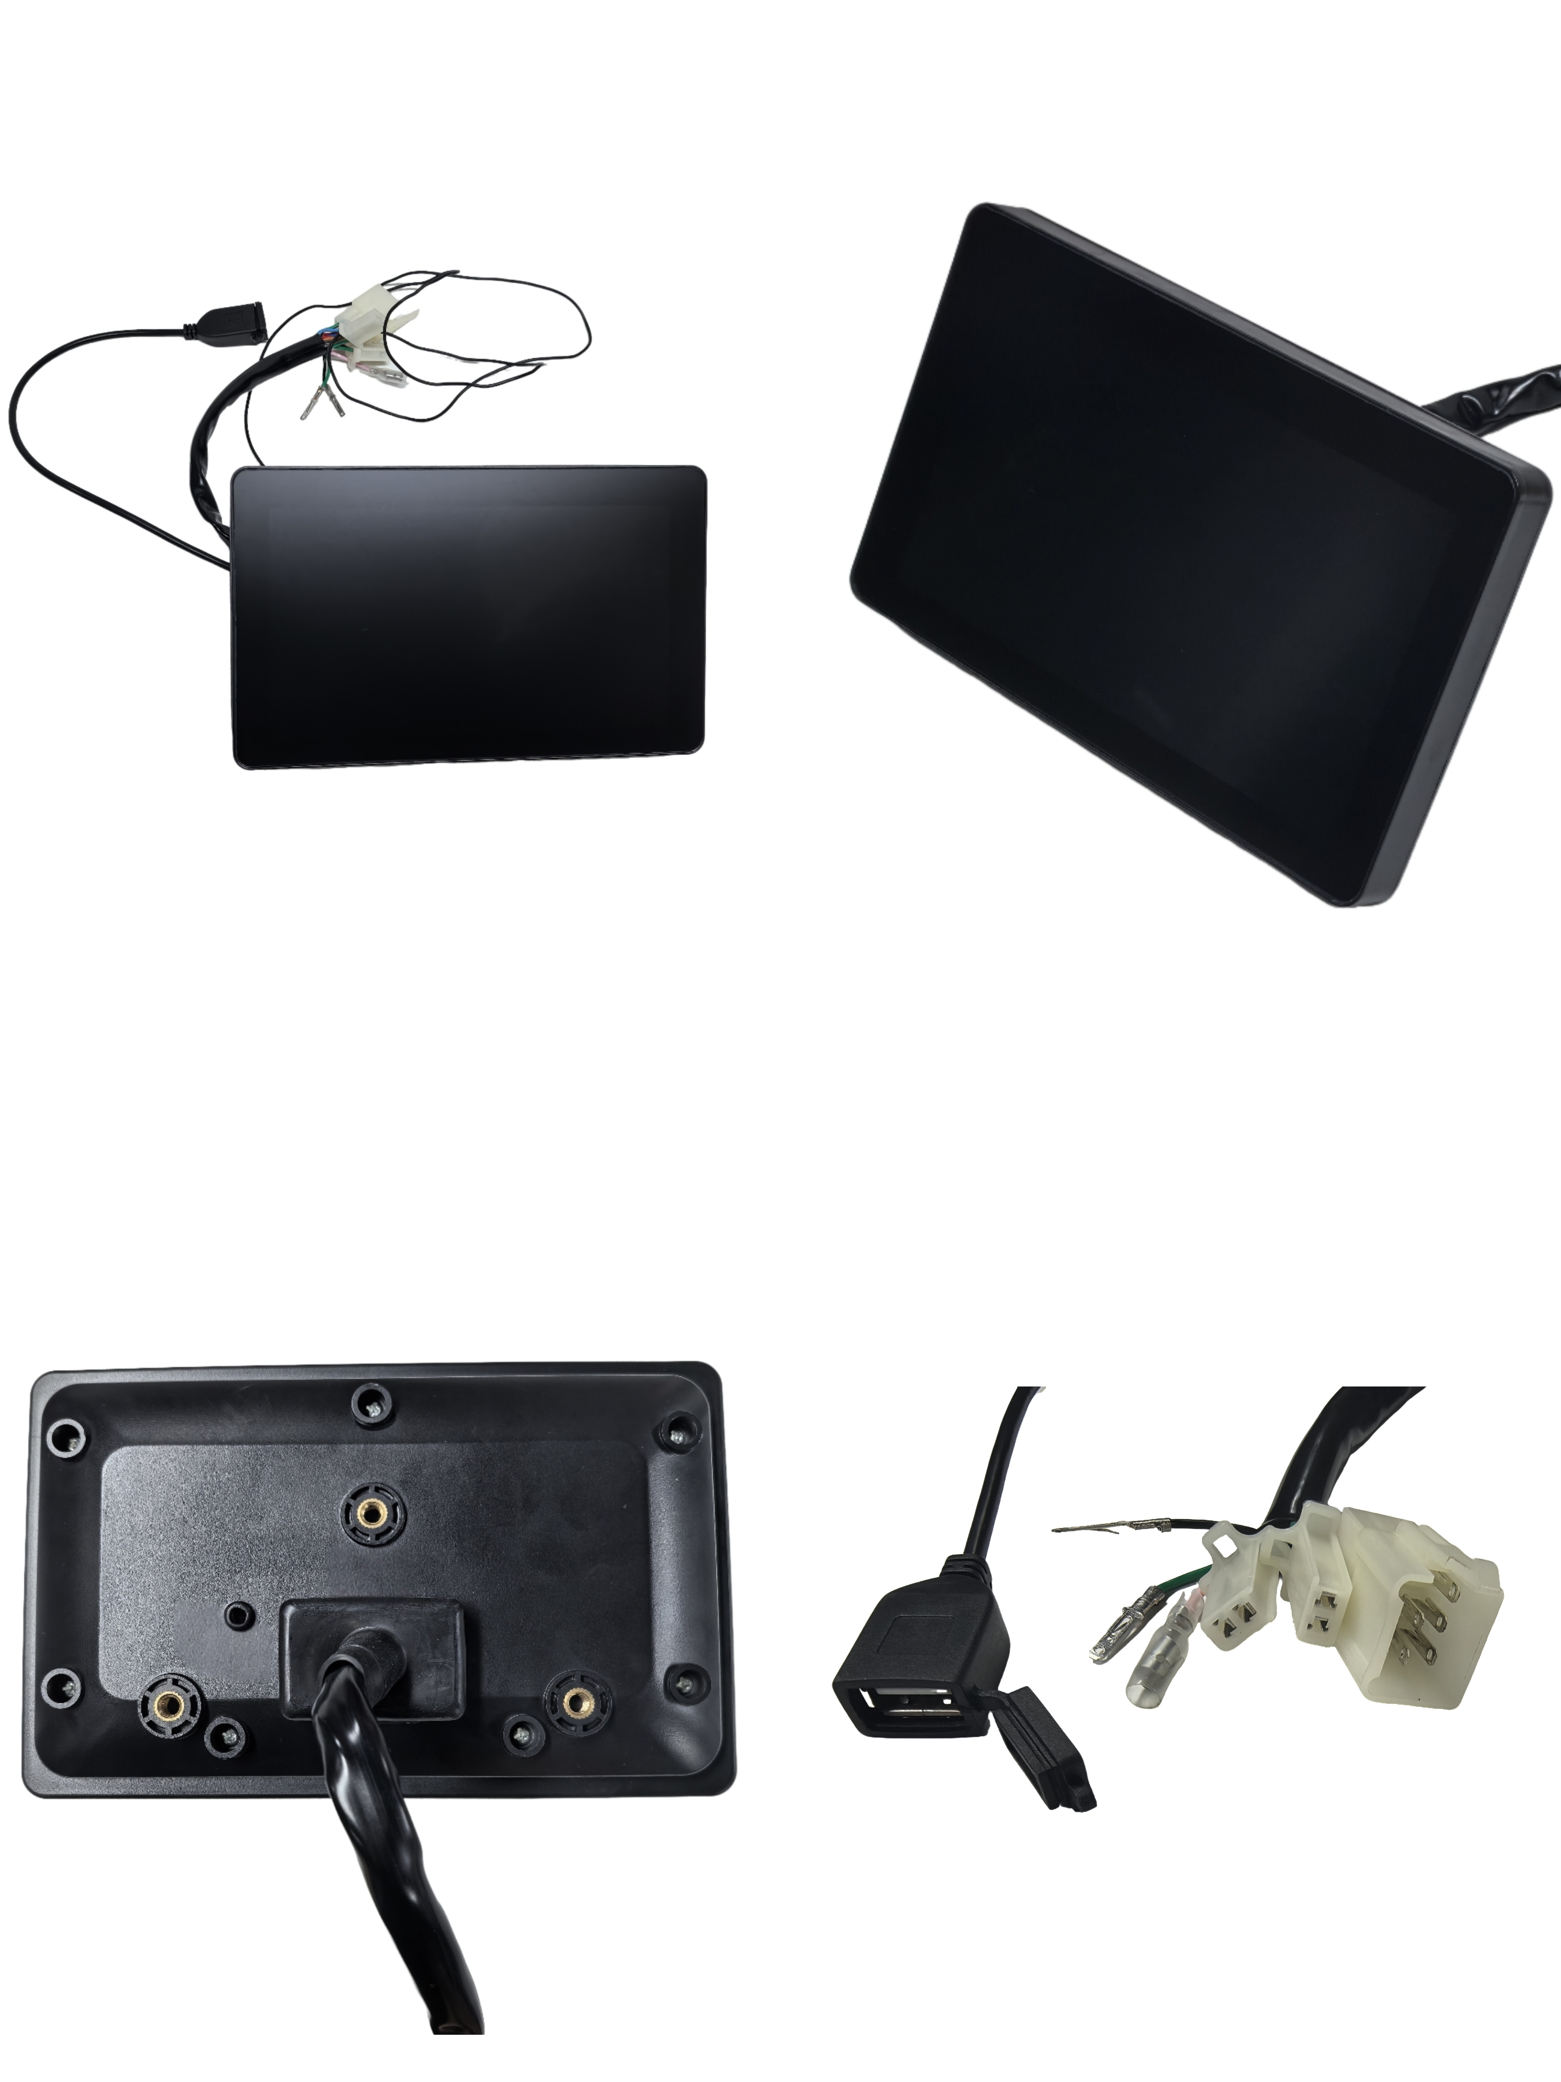
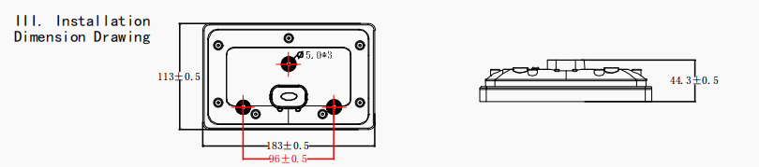
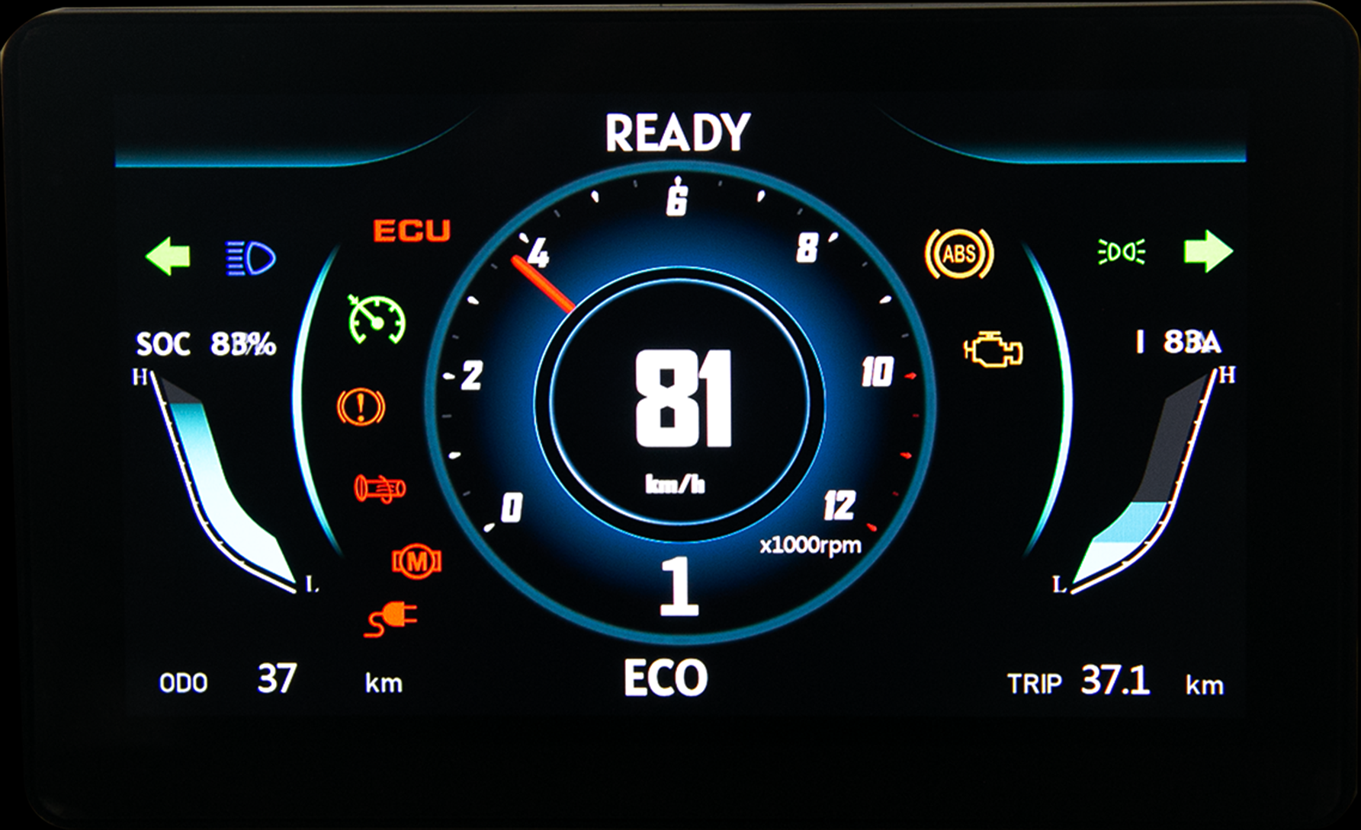
7-inch TFT Display
Appearance
Model
CJ-V7-01
CJ-V7-02

Slide 13
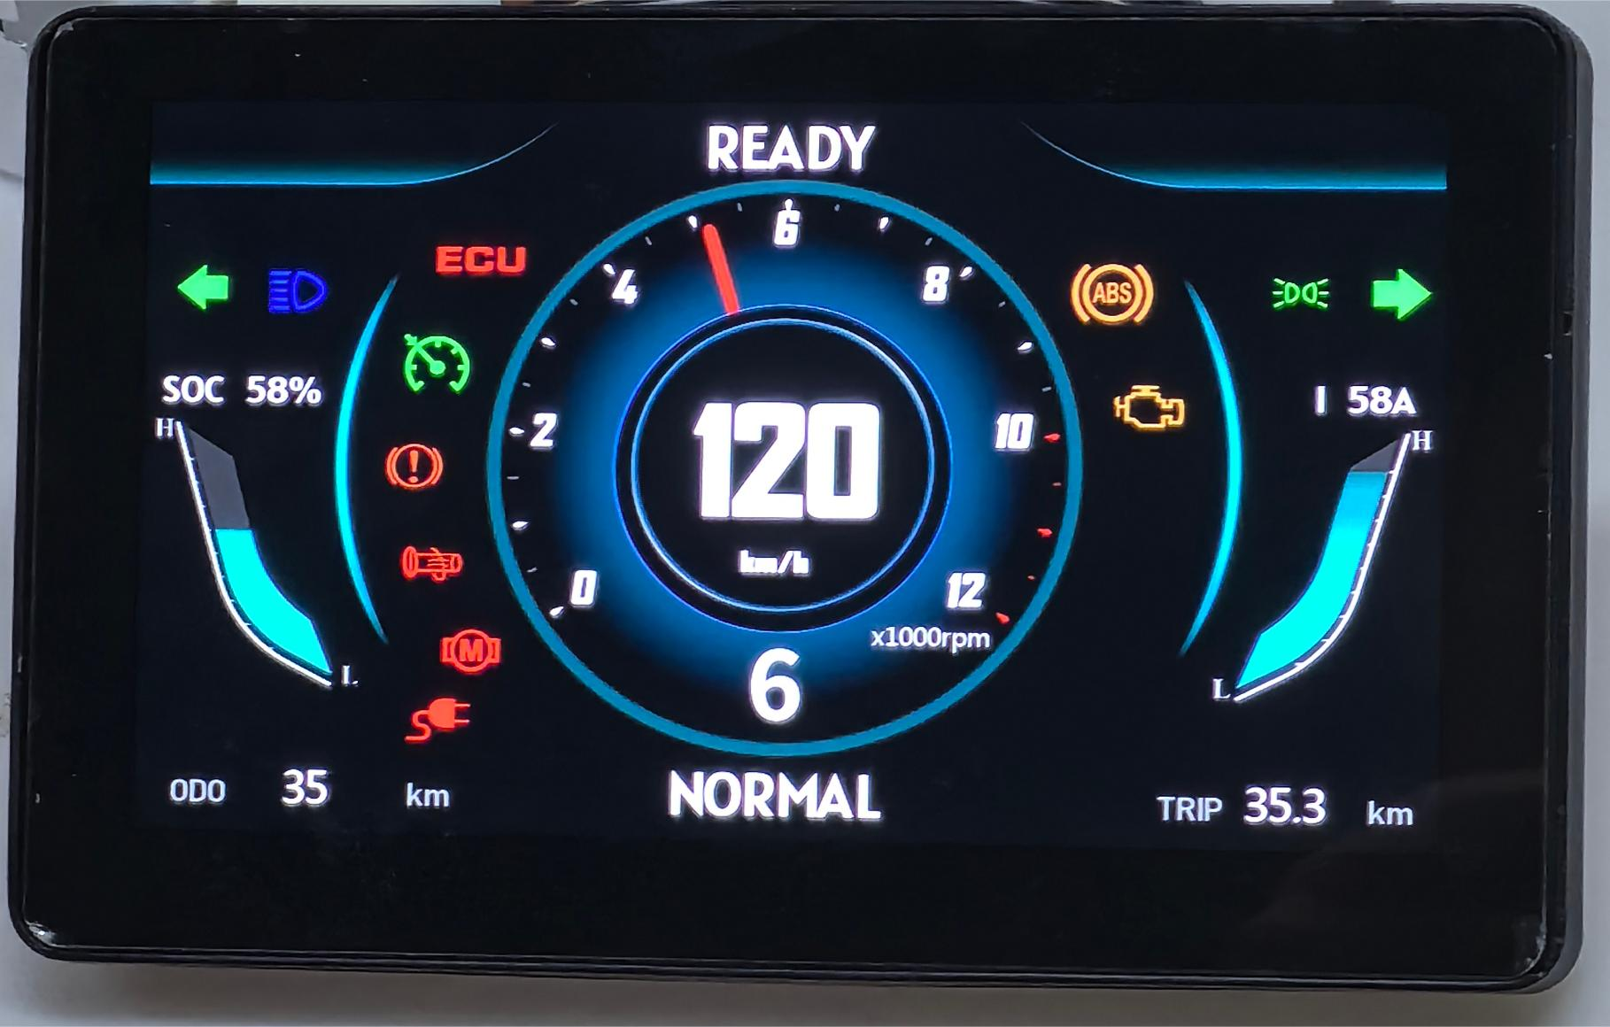
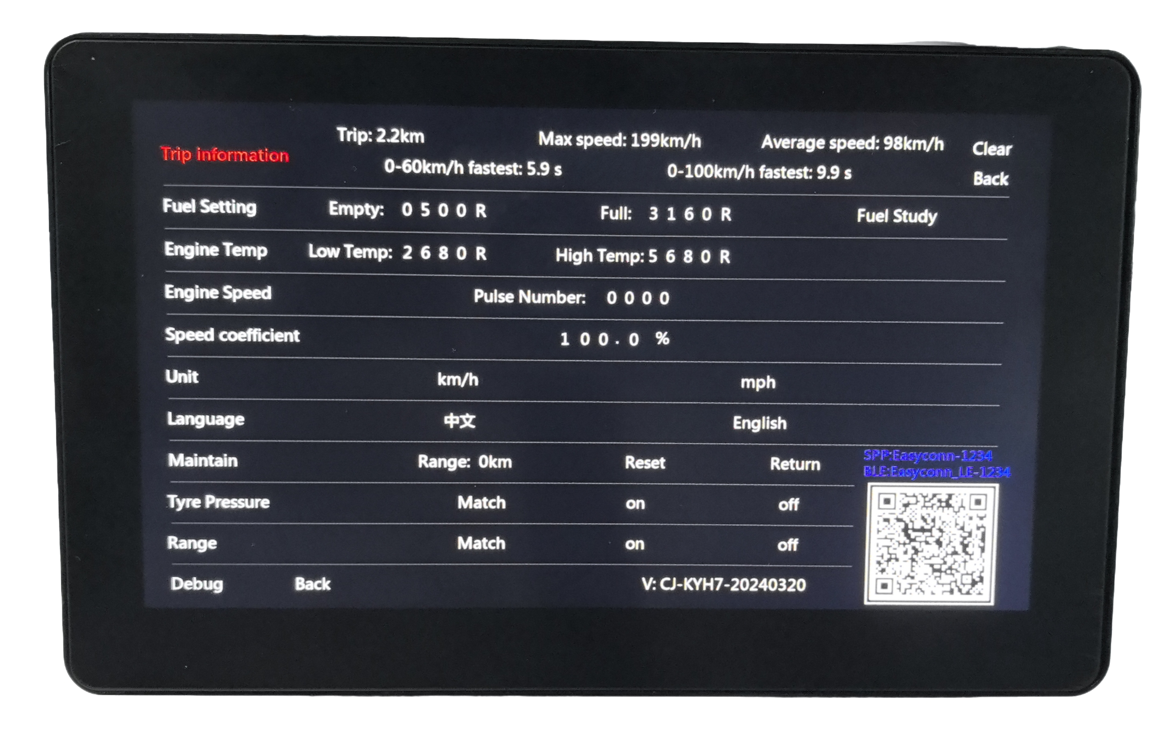
Products
7-inchTFT Display——CJ-V7-01
CJ-V7-01 Functions
Basic Functions | Mobile Phone Bluetooth Connection | Waterproof：IP65
Screen Specifications
Withstand 150V rated voltage | Resolution:1024*600 | Brightness:1000 cd/m²

Slide 14
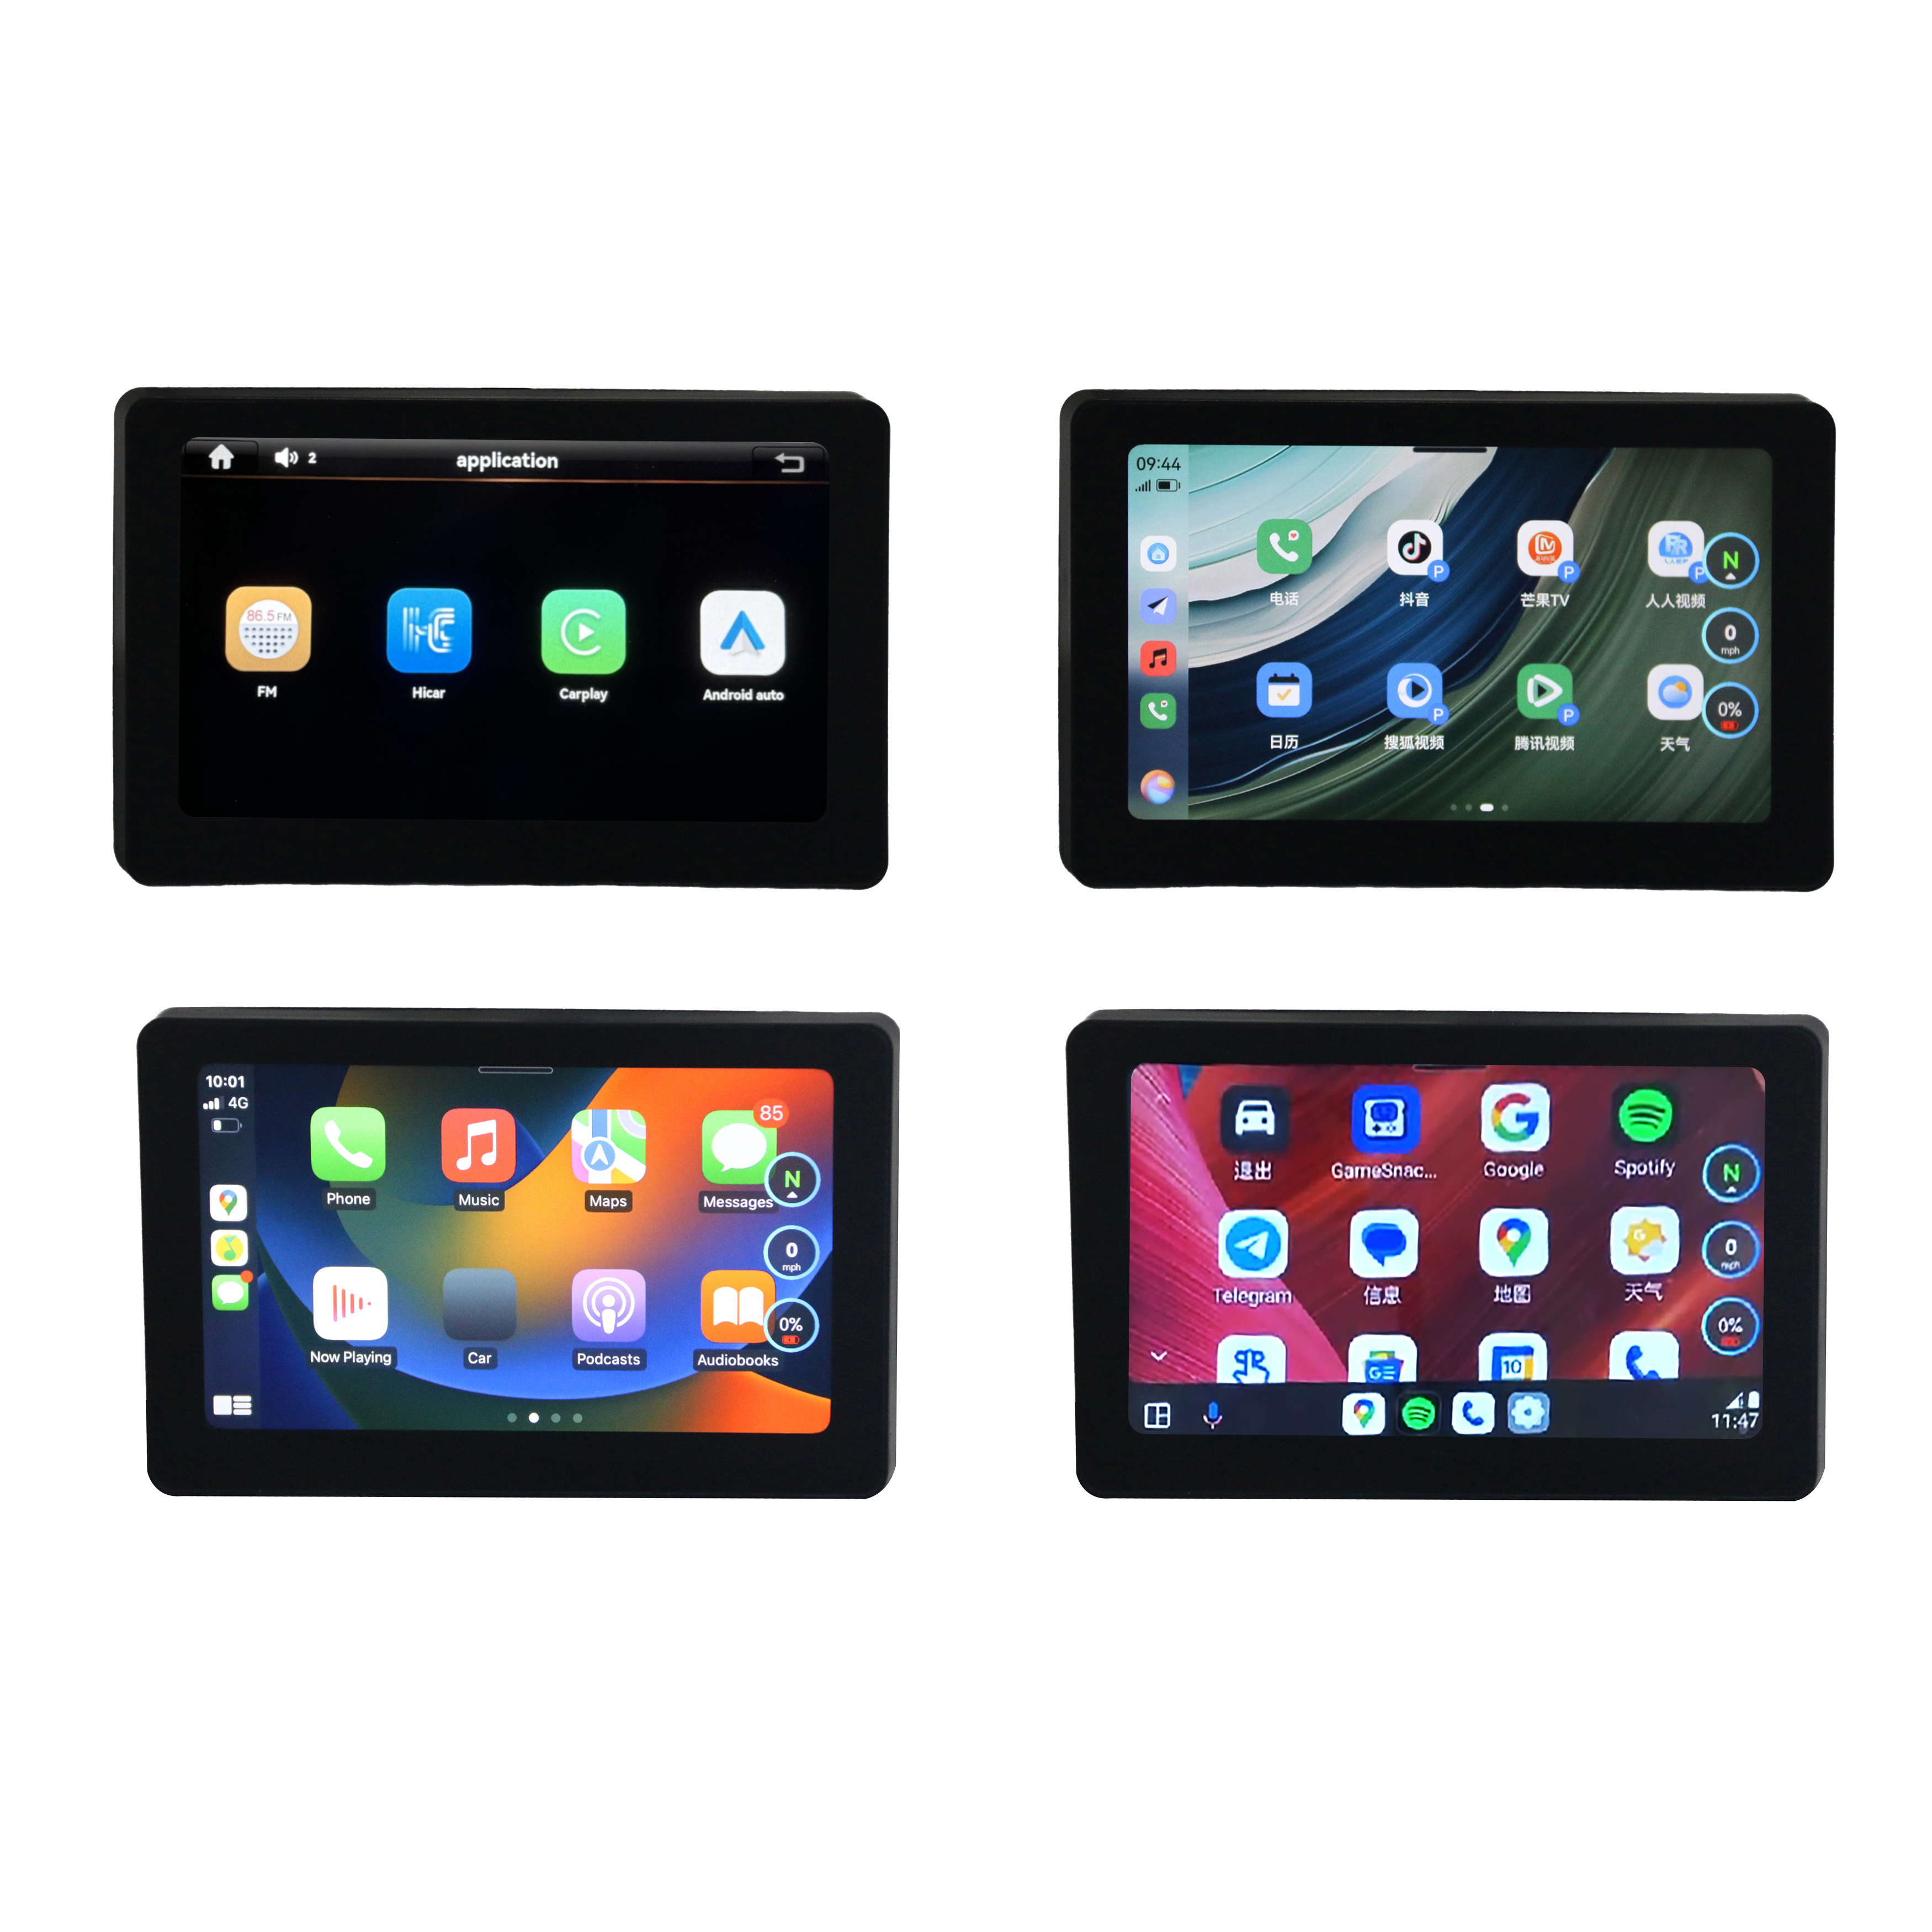
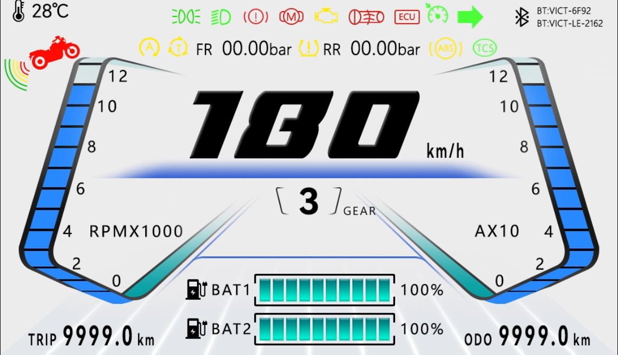
Products
7-inchTFT Display——CJ-V7-02
CJ-V7-02 Functions
Basic Functions | Supports IOS, Android, HarmonyOS mobile phone screen projection | Turn on the headlights to switch backgrounds
Screen Specifications
Withstand 150V rated voltage Dual lithium battery power display | Resolution: 1024*600 | Brightness: 1000 cd/m²

Slide 15
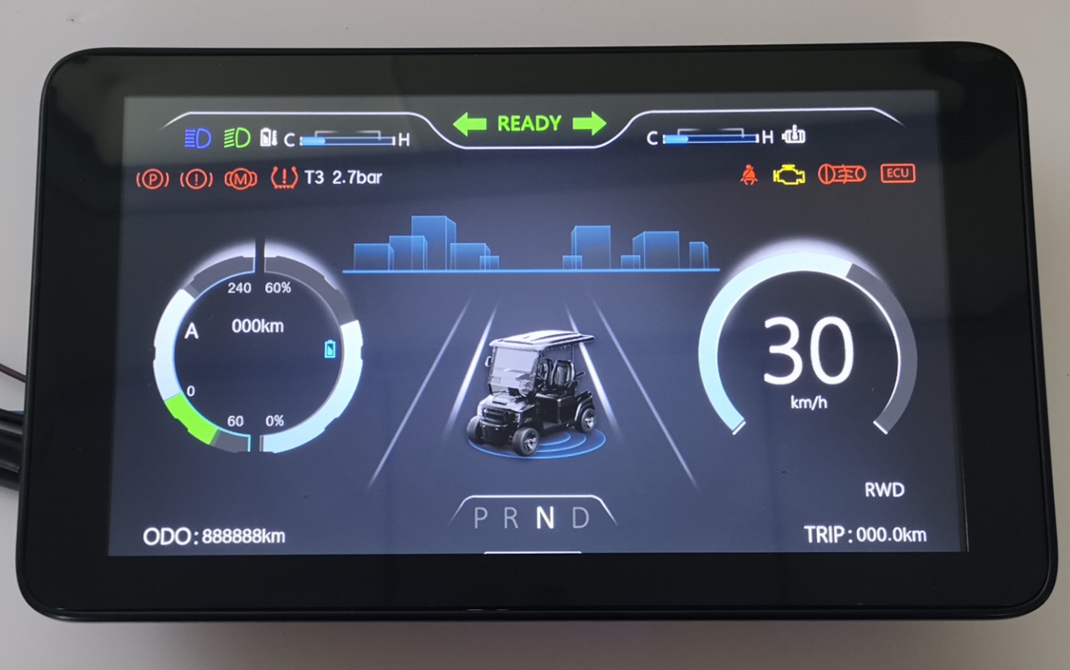
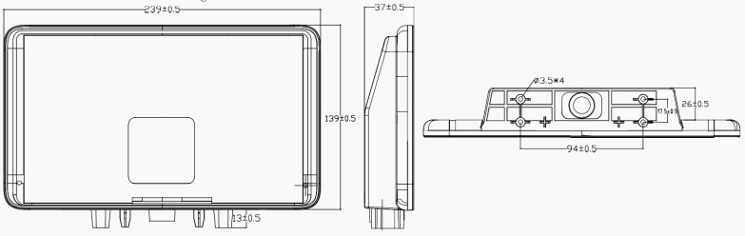
9-inch TFT Display
Appearance
Installation Dimension Drawing

Slide 16
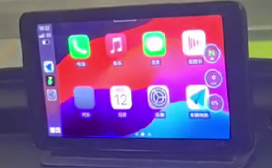
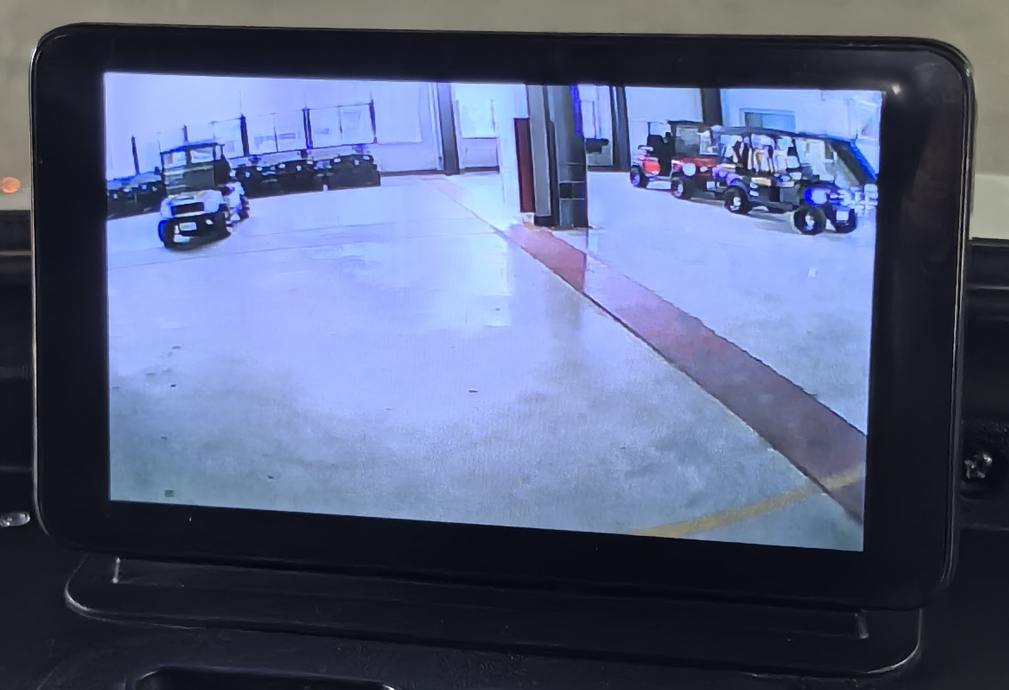
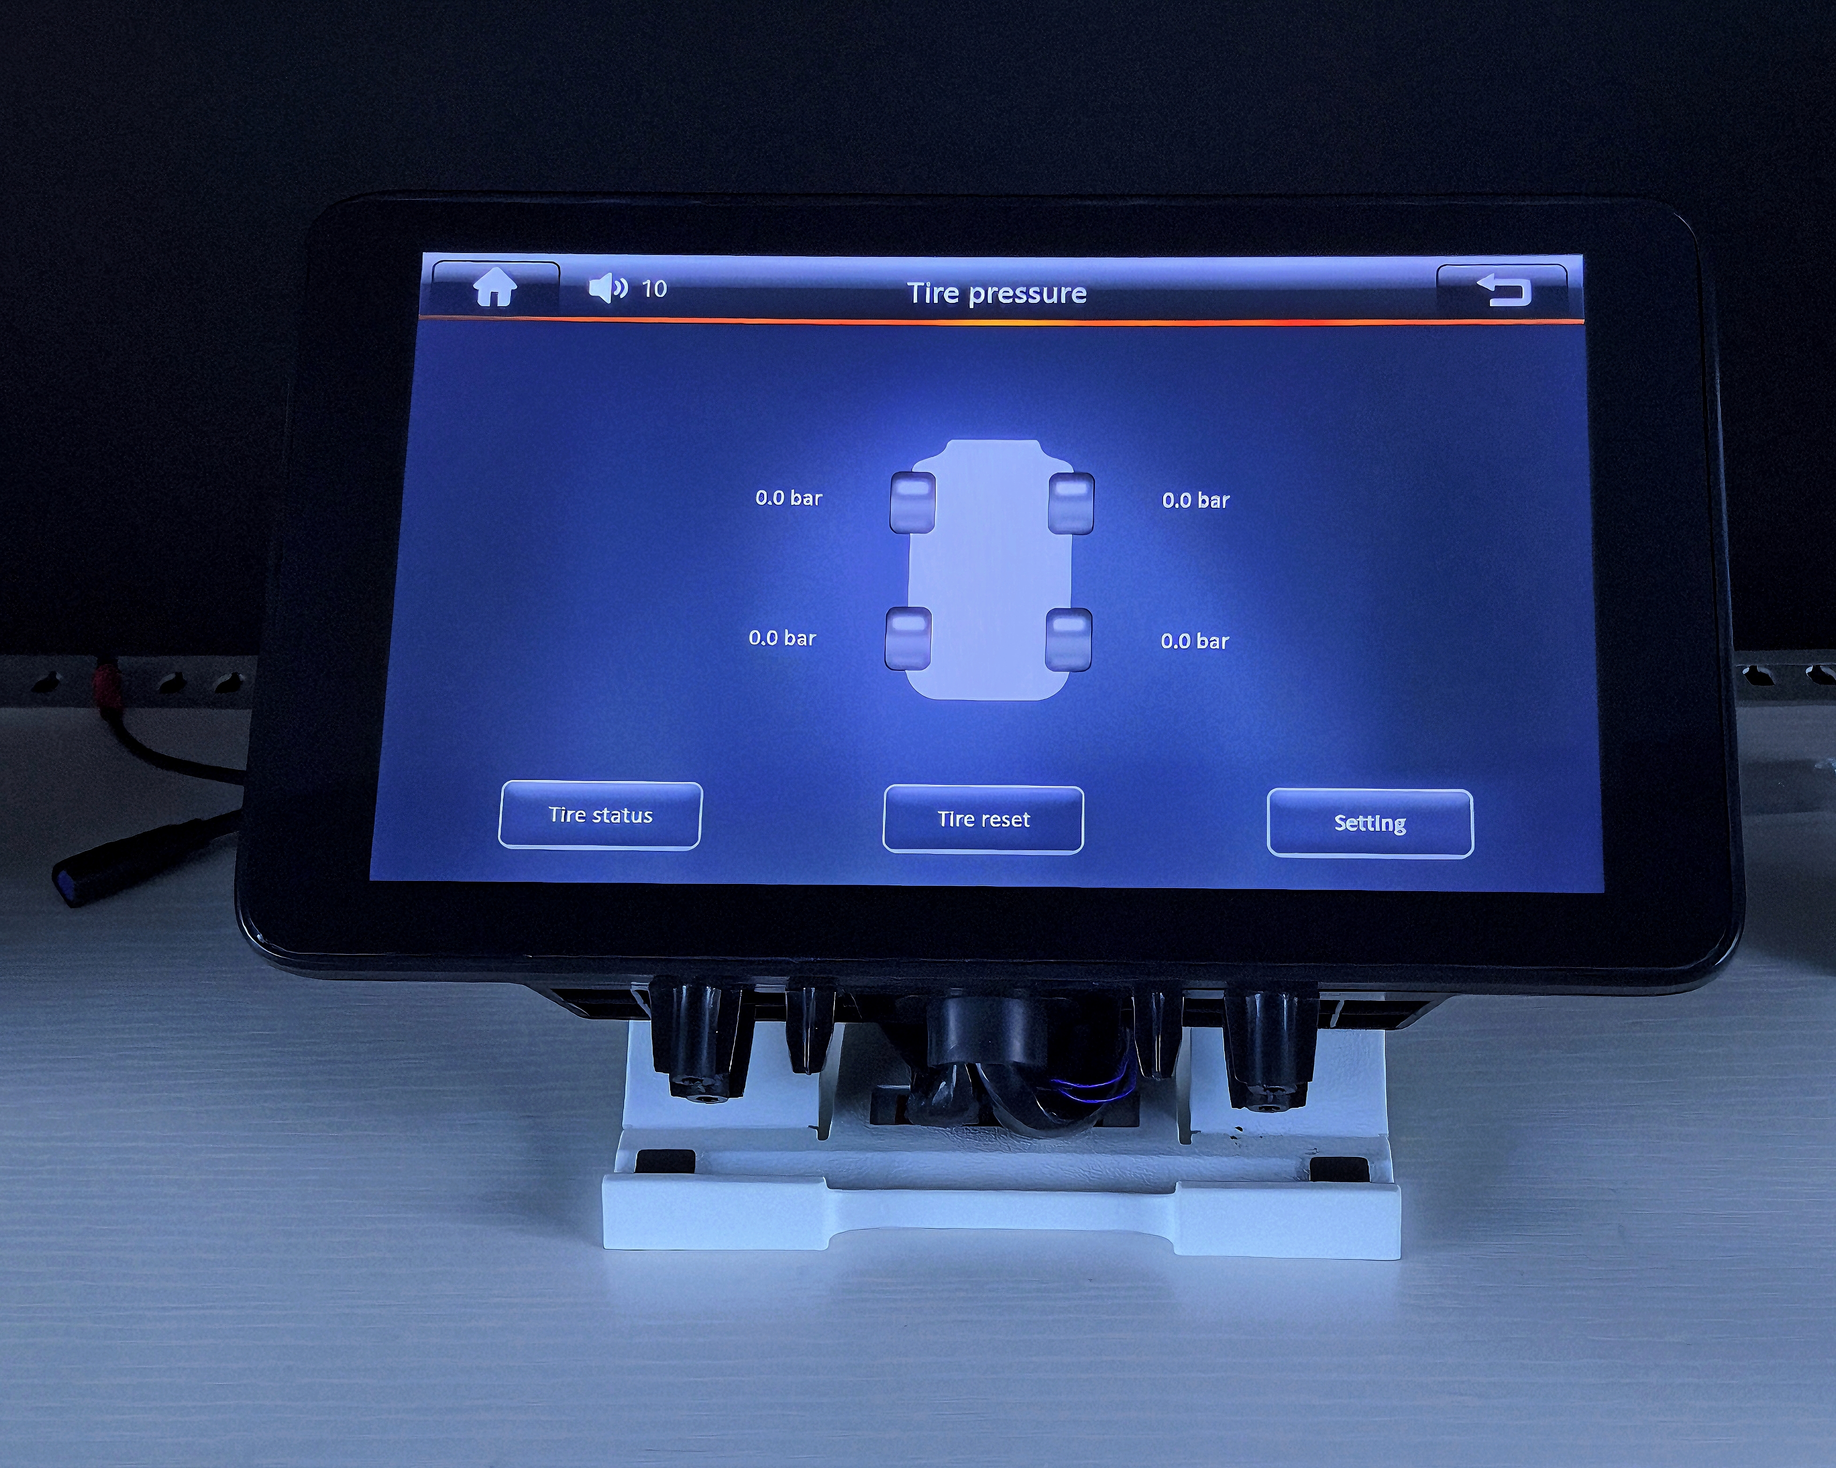
Products
9-inchTFT Display——CJ-V9-01
9寸TFT 仪表——CJ-V9-01
CJ-V9-01 Functions
Basic Functions | Support for mobile iOS and Android (phones supporting Android Auto) systems | Mobile phone casting
Screen Specifications
Withstand 150V rated voltage | Resolution: 1024*600 | Brightness: 1000 cd/m²

Slide 17
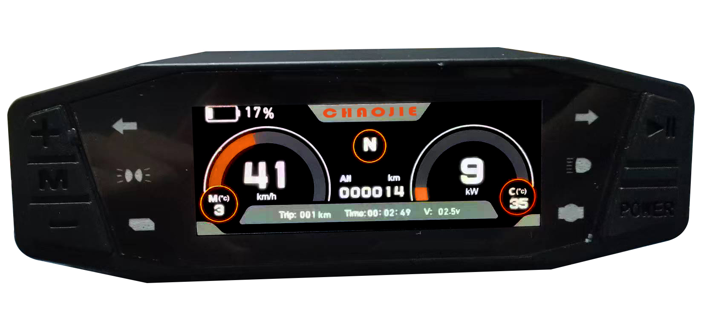
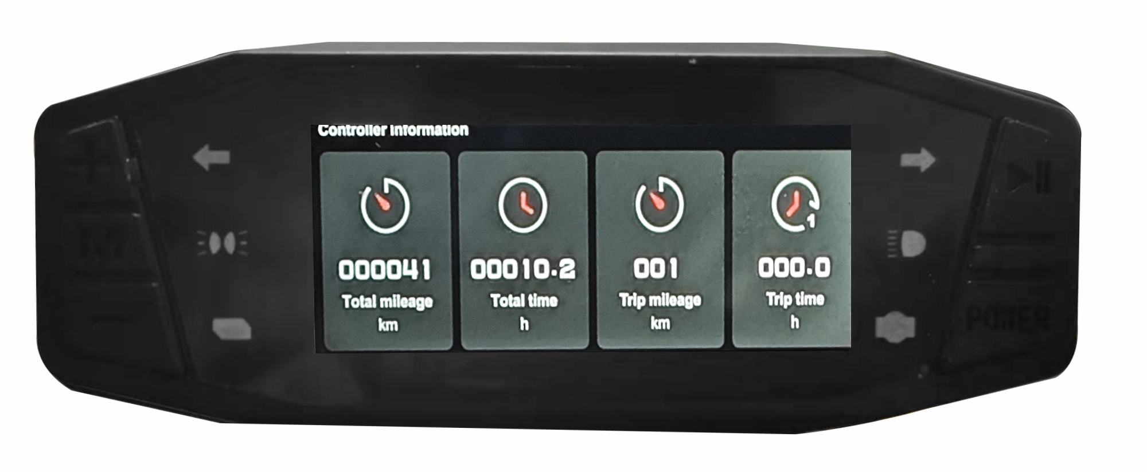
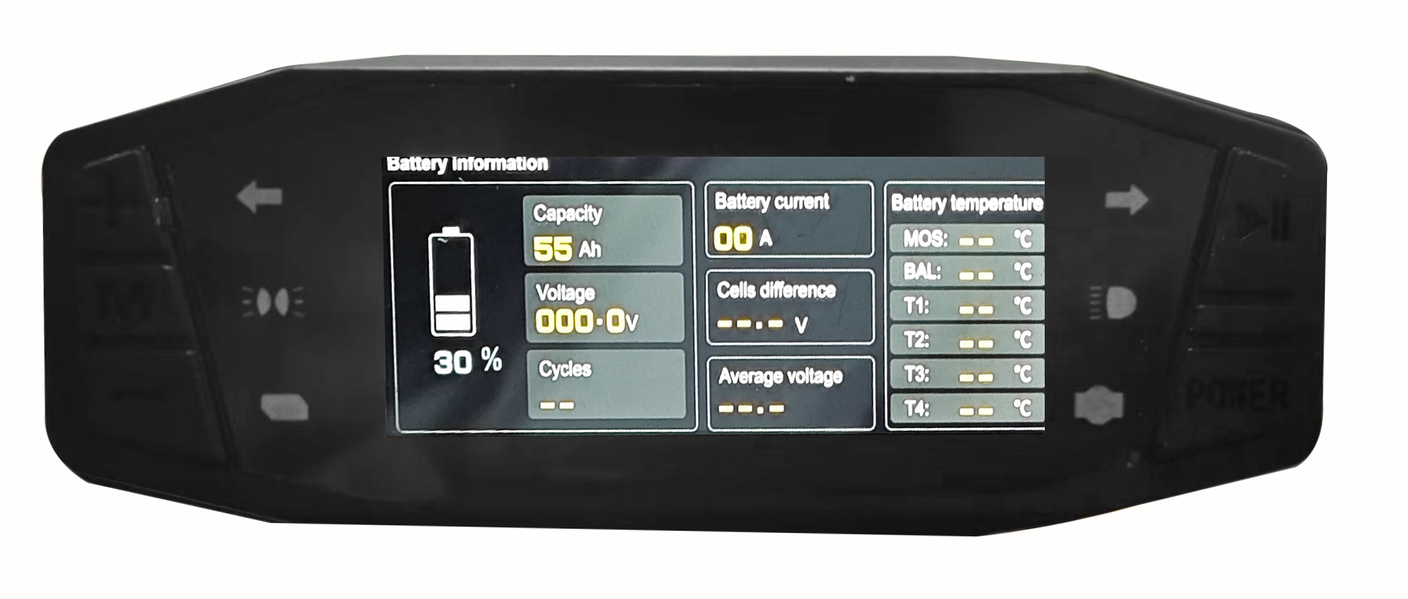
Products
3.13inchTFT Display——CJ-V3-01
CJ-V3-01 Functions
Basic Functions | Tire Pressure Data Display | Display the main data on the BMS and controller via CAN protocol
Screen Specifications
Withstand 120V rated voltage | Resolution: 376*960 | Brightness: 1000 cd/m²

Slide 18
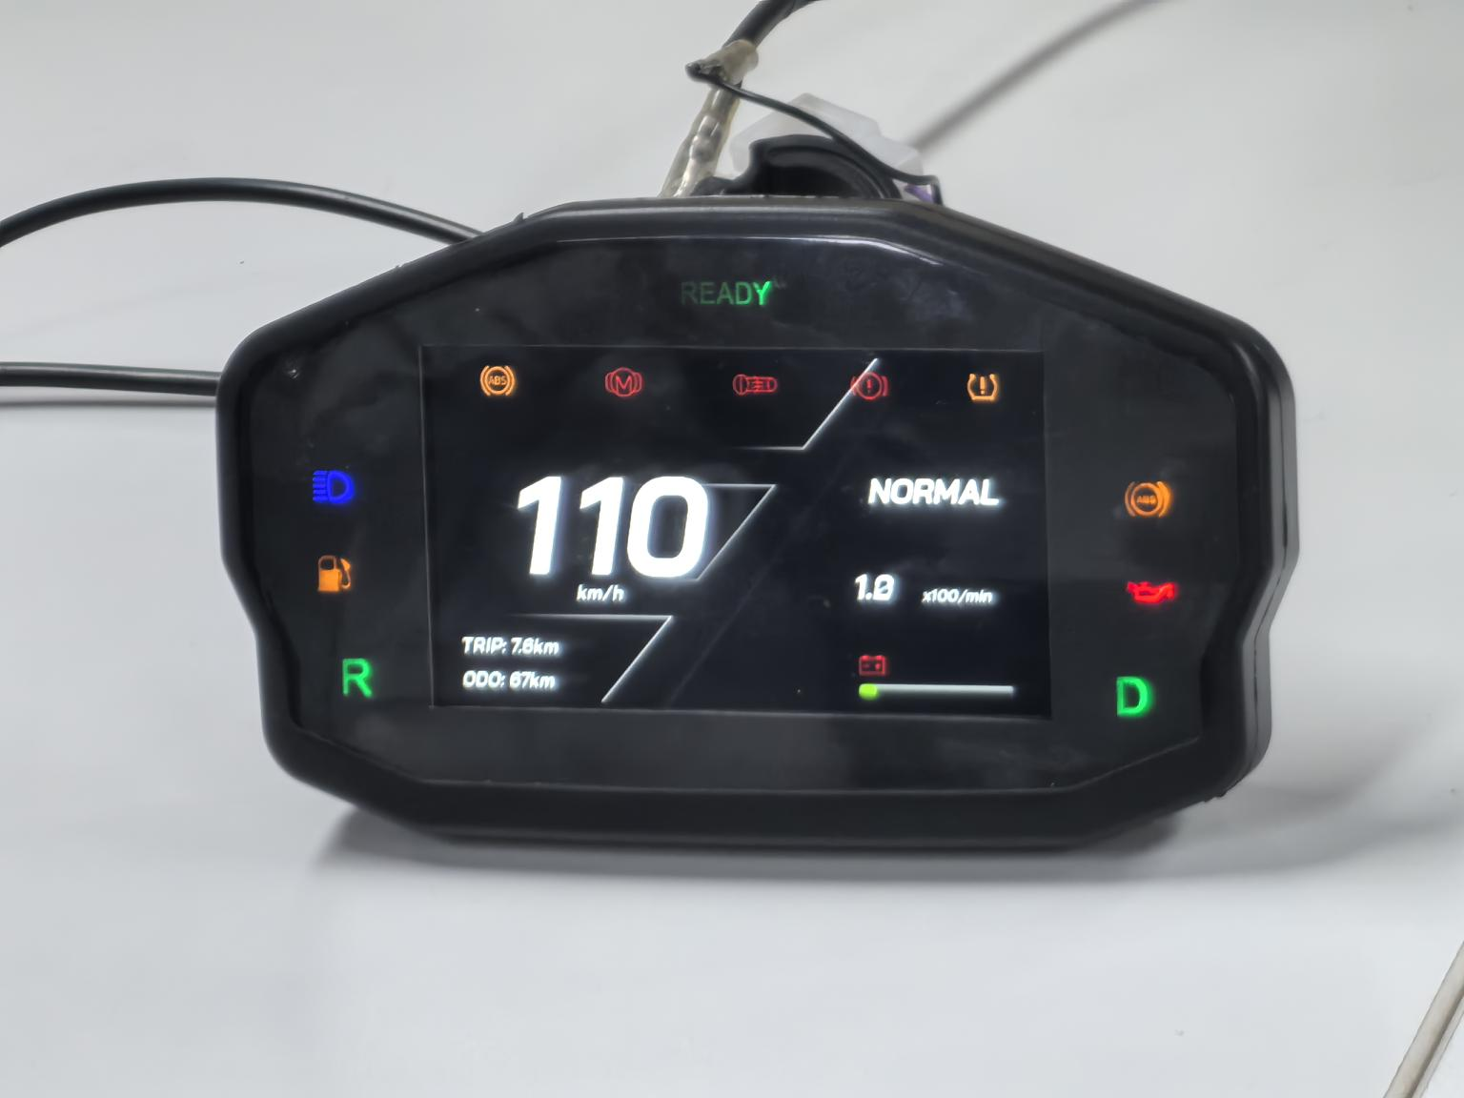


Products
4.3inchTFT Display——CJ-V4-01
CJ-V4-01 Functions
Basic Functions | Audible Alert When Turning Left or Right | Mobile Phone Bluetooth Connection Play Music
Screen Specifications
Withstand 120V rated voltage | Resolution: 480*272 | Brightness: 1000 cd/m²

Slide 19

Customization

Slide 20


